Slide 1
Interreg IPA
Romania-Serbia Programme
2nd Call for proposals
Applicant’s Guide
A greener,
low carbon Europe

Slide 2
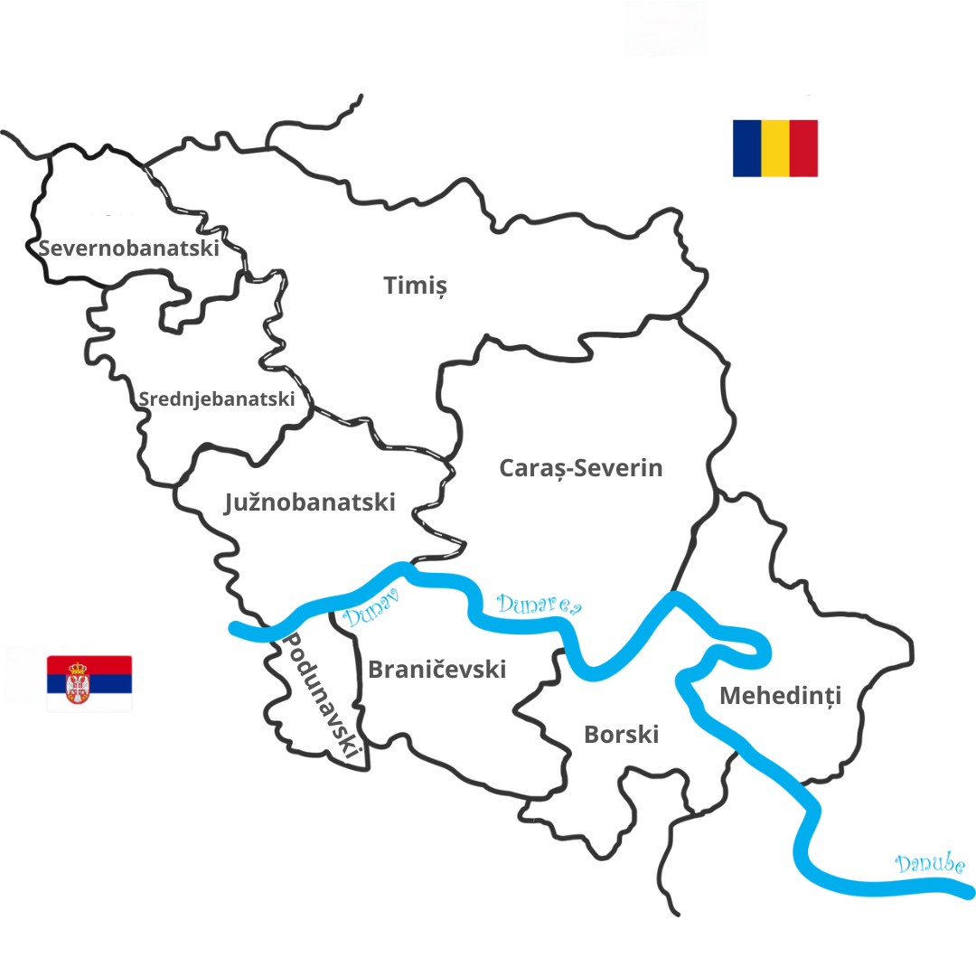
Programme area:
Romania – 3 counties:
Timiş
Caraş-Severin
Mehedinţi
Republic of Serbia – 6 districts:
Severnobanatski
Srednjebanatski
Južnobanatski
Podunavski
Braničevski
Borski

Slide 3
2nd Call for proposals financial allocation
Priority | Union support (Euro) | Total funding (Euro) | Co-financing rate
P1: Environmental protection and risk management | 8,822,677 | 10,379,620 | 85.00%
The total amount allocated to this call for proposals is:
8,822,677 Euro (IPA funds)
S.O. 1.2: promoting renewable energy in accordance with Directive (EU) 2018/2001, including the sustainability criteria set out therein.
S.O. 1.3: promoting energy efficiency and reducing greenhouse gas emissions.

Slide 4
Eligibility of applicants
Minimum number of partners: | 2 | One from each side of the border
Maximum number of partners: | 5 | Including the Lead Partner
Partners must fulfil the following criteria:
Be non-profit making bodies (in the sense of art. 195, of Regulation (EU, Euratom) 2024/2509) and legally established according to the national legislation of the state on whose territory they are located.

Slide 5
Eligibility of applicants
Partners must fulfil the following criteria:
Be directly responsible for the preparation and implementation of the action together with their partners and not acting only as an intermediary;
Have stable and sufficient sources of finance to ensure the continuity of their organization throughout the project and to play a part in financing it;
Be able to implement the project in the Programme area and demonstrate their financial and administrative capacity to manage their share of the project;
Have not received financing support from public funds in the past 5 years before the deadline for submitting the applications under this call for proposals for the same type of operation in terms of objectives, activities and results;

Slide 6
Eligibility of applicants
! Partnerships not involving strong commitment and contributions from the part of all partners shall be rejected !
Partners shall cooperate in the:
Development (project must be designed in common by partners from both sides of the border);
Implementation (activities must be carried out and coordinated among partners on both sides of the border);
Financing (there will be only one contract per project and there must therefore be one joint project budget, proportional to the activities carried out by each partner and should reflect the cross-border character of the project);
Staffing, if needed (the project should not duplicate functions in the project management team on either side of the border).

Slide 7
Project duration & budget
Specific objective | Minimum duration | Maximum duration
1.2 - Promoting renewable energy in accordance with Directive (EU) 2018/2001, including the sustainability criteria set out therein. | 12 months | 24 months
1.3 - Promoting energy efficiency and reducing green-house gas emissions. | 12 months | 24 months
The IPA funds requested for one project will range between
2,000,000 EURO – 4,000,000 EURO.

Slide 8
Eligible types of actions & indicators
Specific objective 1.2:
Solutions developed through joint “pilot actions” in renewable energy (e.g. wind, solar, geothermal).
Specific objective 1.3:
Investments in energy efficiency measures regarding public infrastructure.
Promotion of energy efficiency and resource efficiency measures.
Demonstration projects and initiatives for reducing emissions of green-house gas and air pollutants.
Investment in supporting measures for reducing emissions of green-house gas and air pollutants.
RCO 84 - Pilot actions developed jointly and implemented in projects.
RCR 104 - Solutions taken up or upscaled by organisations.

Slide 9
One single project can address both specific objectives, combining eligible types of actions of the two.
If that will be the case for your project,
please mention that clearly in all the relevant sections of the concept note (III.1, III.5, III.6, III.7).

Slide 10
The Programme indicators:
Pilot actions developed jointly and implemented in projects & Solutions taken up or up-scaled by organisations
Solution/s
Pilot action 1
Pilot action 2
Pilot action x
Solution/s taken up or upscaled
outputs
results

Slide 11
The output/s: Pilot actions developed jointly and implemented in projects
pilot actions developed jointly and implemented by the project. The scope of a jointly developed pilot action could be to test procedures, new instruments, tools, experimentation, or to transfer practices.
the pilot action needs not only to be developed, but also implemented within the project, meaning that the implementation of the pilot action should be finalized by the end of the project.
an output is defined for each pilot action developed and implemented.
the project can define as many outputs as pilot actions is developing and implementing.
when describing the output, please put an emphasis on its novelty character and its contribution to the project`s specific objective.
for more details, please see the Applicant`s Guide, pages 26-30

Slide 12
The result/s: Solutions taken up or upscaled by organisations
are the solutions stemming from the pilot actions that are developed by the project and are taken up or up-scaled until the end of the one-year period after project completion;
each “solution taken-up or upscaled” represents a result delivered by the project;
the organisation adopting the solutions deriving from the pilot actions developed by the project may or may not be a participant in the project;
the uptake / up-scaling should be documented by the adopting organisations in, for instance, strategies, action plans etc.;
the contribution to this indicator will be measured at 1 year after project completion.
for more details, please see the Applicant`s Guide, pages 26-30

Slide 13
Eligibility of actions (operations)
! Applicants are asked to demonstrate that the project activities have cross-border impact on the Programme area, contribute to the objectives of the Programme and that the results cannot be achieved without cross-border cooperation.
Activities for which funding is sought have to be carried out in the area of the Programme.
As an exception, a part of an operation may be implemented outside the Programme area but within the territory of the countries participating to the Programme, provided that the activities contribute to the objectives of the Programme and are in the benefit of the Programme area, with explicit approval by the Managing Authority in the Monitoring Committee.
All operations have to fall within the scope of the type of actions defined in the Applicant`s Guide under each Specific Objective - in the Application Form, under section “Project overall objective”, the applicant shall clearly specify to what type(s) of action(s) it contributes.

Slide 14
Eligibility of actions (operations)
The Programme will only finance investment projects which dedicate at least 50% of their budget to investments (as described in JeMS).
Investments (“Infrastructure & works” and “equipment” expenditures) linked to an Investment defined in JeMS, shall be done only in the Programme area.
Investment expenditure NOT LINKED with an Investment in JeMS, WILL NOT be considered as Investment and WILL NOT be calculated as part of the 50% of the project budget dedicated to investments.

Slide 15
Eligibility of expenditure
The projects should include details that allow for the evaluators to assess that the project complies with the ”sound financial management principle”:
Economy - the resources used by the institution concerned in the pursuit of its activities shall be made available in due time, in appropriate quantity and quality, and at the best price.
Efficiency - the best relationship between the resources employed, the activities undertaken and the achievement of objectives.
Effectiveness - the extent to which the objectives pursued are achieved through the activities undertaken.

Slide 16
Eligibility of expenditure
The eligible costs must be based on real costs, except for the lump sums and flat rates, which are automatically calculated:
Project preparation lump sum - 15,882 euro (total costs) at project level, for project preparation expenditures for infrastructure investment projects or 11,765 euro (total costs) at project level, for project preparation expenditures for equipment investment projects;
Staff costs flat rate – up to 20% of the direct costs other than the direct staff costs, at partner level;
Travel & accommodation flat rate – up to 15% of the direct staff costs, at partner level;
Office & administrative costs flat rate – up to 7% of eligible direct costs, at partner level;
Project closure lump sum - 3,529 euro (total costs) at project level.
Costs in relation to procurement of services, supplies and works are eligible in gross amount meaning with VAT included.

Slide 17
Project application
2 Steps submission:
STEP 1: submission of Concept note (via e-mail)
STEP 2: submission of full application form (concept notes over 70 points, falling within the financial allocations - via JeMS)
Deadline for submission of concept notes: 3rd of March 2025
Working group comprised by MA, NA and JS members helping the beneficiaries to draft the full application form
Proposed deadline for submission of full application form: 1 month following the MC decision

Slide 18
Project application
Step 1:
The deadline for submitting the Concept Notes is the 3rd of March 2025 (16 o’clock, Romanian local time) via e-mail:
ipacbc@brct-timisoara.ro
romania-serbia@mdlpa.gov.ro.
Only Concept Notes within the financial allocations of this call for proposals will be invited to draft a full application form

Slide 19
Project application
Step 2:
After the selection of the Concept Notes by the MC, the concept notes falling within the financial allocations will be requested to submit a full application form within one month after the MC decision on the selection of the Concept Note.
A working group comprised by MA, NA and JS members will be organized, helping the beneficiaries to draft the full application form in line with the Programme documents.
Following the submission of the full application forms, an Evaluation Committee will assess the project proposals, in line with the assessment criteria approved by MC.
The application process shall be done through the Programme’s Joint Electronic Monitoring System (JeMS)

Slide 20
Thank you!

