Slide 1
Interreg IPA
Romania-Serbia Programme
Reporting in Jems

Slide 2
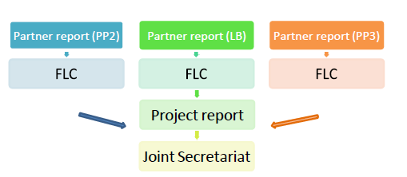
Reporting process:
Step 1 - Each partner has to fill in and submit his own report to the FLC in Jems;
Step 2 - First Level Controllers (FLC) will verify the reports and certify the expenditures in the system;
Step 3 - The Lead Partner (LP) will prepare a consolidated project report, include the FLC certificates of the partners and submit it to Joint Secretariat (JS).

Slide 3
    PROJECT REPORTING in Jems
Project reports are created by the Lead Partner, based on partner reports previously verified and certified by FLC;
The LP will have to include the FLC certificates of all the reporting partners (including the one issued for its own organization);
Project reports can only be created by the Lead Partner of a project, starting from the moment the project status is changed to ‘contracted’.

Slide 4
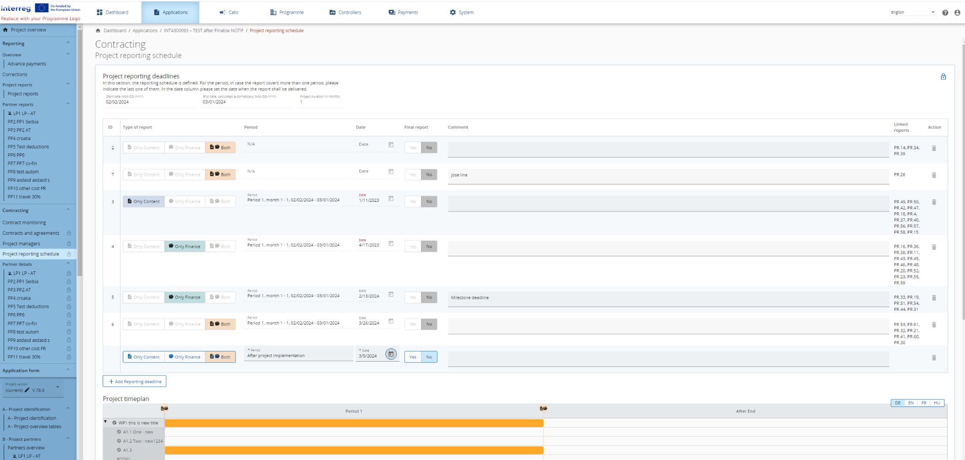
    Project reporting schedule
- the project reporting deadlines are set in the section Contracting/Project reporting schedule by the JS for each project

Slide 5
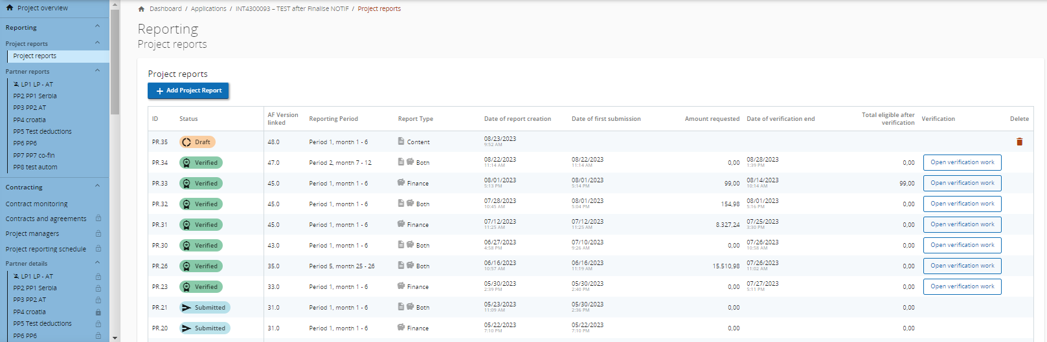
    Creation of Project reports
When a user has the edit rights as Application Form users/Project managers within the project privileges overview, the user can create project reports.

Slide 6
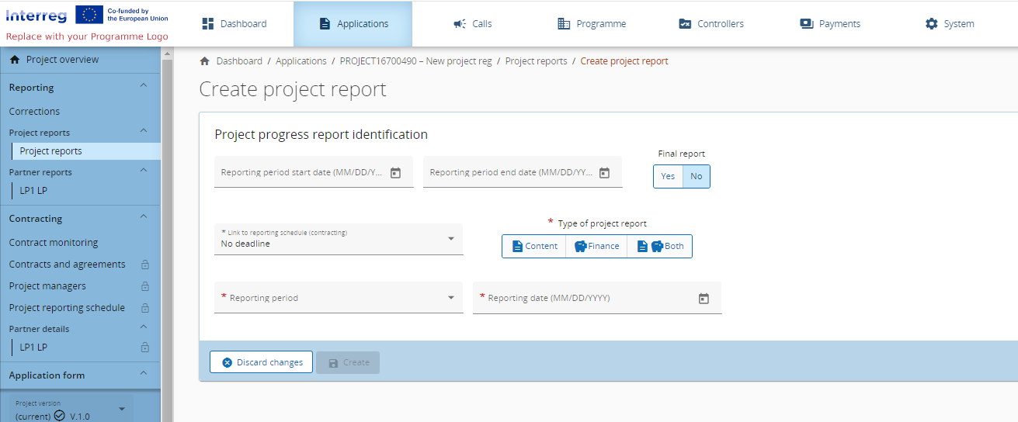
    Creation of Project reports
When the “+Add Project Report” button is clicked, you land on the “Create project report” form.

Slide 7
    Project report identification
Application form data in the Project report
Important to note is that the data from the last approved application form version is taken into the project report in the moment of its creation. Ongoing modifications will have no impact on the data in existing reports.
Once the Project report is created you will land on the first tab called Project report identification.
The tab includes textboxes to describe the Highlights of main achievements and Partner problems and deviations. In addition, the tab includes the following overview tables as described below:
Overview of Project outputs and result overview
There is an overview of Output and result indicators which they are shown in one table in this section. Values are cumulative. Whenever a report is submitted and a new report is created the values from the previously submitted report are added to the previously reported column.

Slide 8
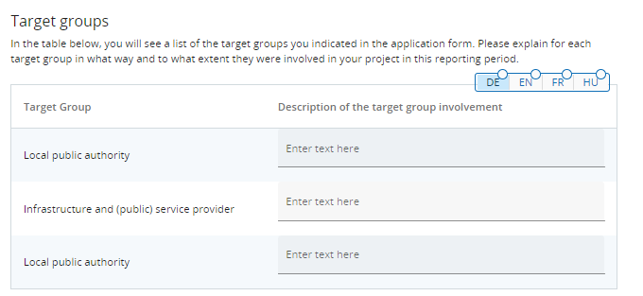
    Project report identification
Partner spending profile (in Euro)
Another table is the spending profile (in Euro). This table corresponds to the certificates included in the List of certificates tab. The table shows by default all partners in the project. In case a partner has multiple certificates included in one Project report, the data from the last certificate and forecast is displayed here (providing the most accurate cumulative values and forecast).
Target Groups
Here, project managers are requested to describe the target group involvement during the indicated reporting period.

Slide 9
    Project report - Work plan progress
In this section you shall describe the progress on work packages including the project specific objective and communication objective, the planned investments, activities, deliverables and outputs.
Structure of the Work package reporting
At the top of each Work package form, there is a tickbox to confirm whether “This work package is completed.”
The progress made on the Project specific objective and the Communication objective is to be described and there is a field to select the Status of the objectives. You can select, if the objectives have been “Fully achieved”, “Partly achieved” or “Not achieved”. Further, there is a textbox to describe the overall progress in the work package.

Slide 10
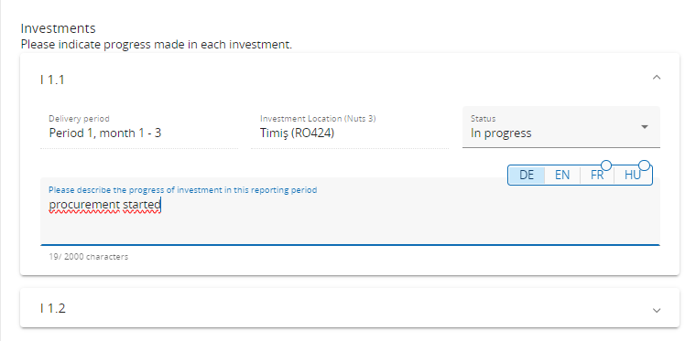
    Project report - Work plan progress
For each Investment, Activity, Deliverable and Output there is a separate section with text fields to describe the progress in the reporting period. Similar as for objectives, for each activity there is a field to define the Status.

Slide 11
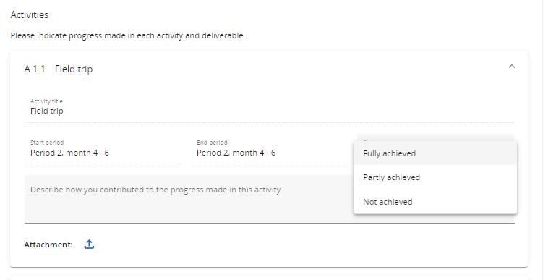
    Project report - Work plan progress

Slide 12
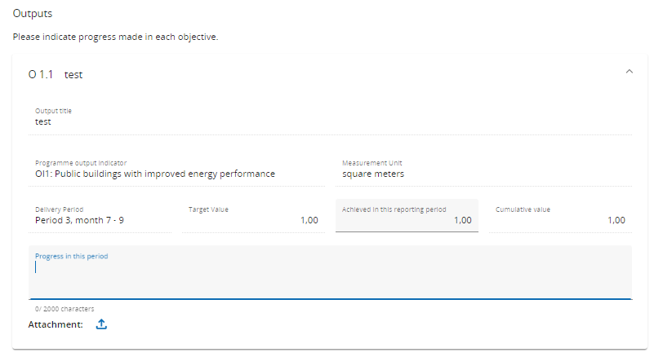
    Project report - Work plan progress
For Deliverables and Outputs, there is also a number field available to fill-in how much was achieved in this reporting period. In this field, you can fill in a positive or negative number. Negative numbers could be used to correct achievements wrongfully reported in previous Project reports.

Slide 13
    Project report - Work plan progress
Deliverables and Outputs are cumulative, meaning that if a report is submitted and another report created the values from the previous report are added to the cumulative values. The cumulative value achieved is calculated as the sum of all previous Project reports with the status submitted.
You can also upload an attachment per item which will show up in the Project report annexes.
In case multiple files should be uploaded per item, it is recommended to upload a zip or rar file.

Slide 14
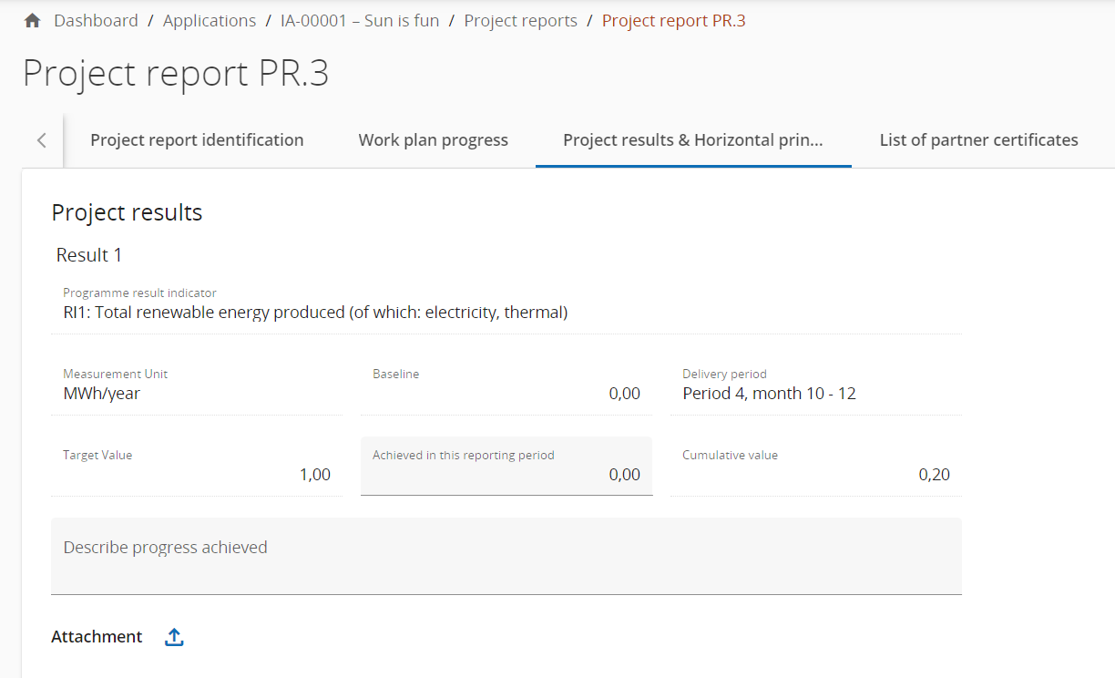
    Project report results & Horizontal principles
Project results
You shall describe the progress on planned results by inserting how much was achieved in this reporting period.
Results are cumulative, meaning that if a report is submitted and another report created the values from the previous report are added to the cumulative values.
The cumulative value achieved is calculated as the sum of all the figures reported in all Project reports with the status submitted.
You can also upload an attachment per item which will show up again in the Project report annexes.

Slide 15
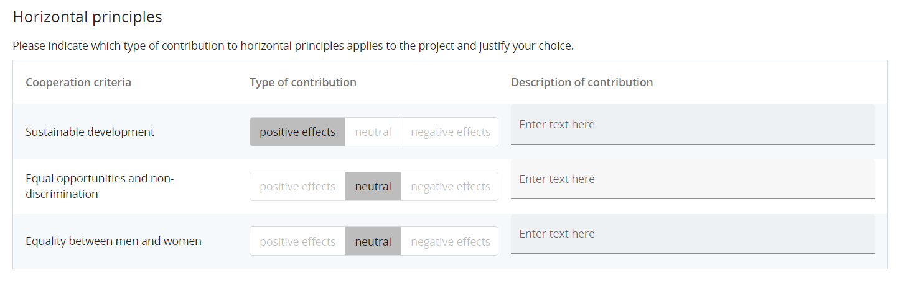
    Project report results & Horizontal principles
Horizontal principles
For Horizontal principles there is a table to report on the contribution for each of the three cooperation criteria. The Type of contribution is pre-defined from the latest approved application form and cannot be changed. There is a text field to describe the contribution made in the respective reporting period.

Slide 16
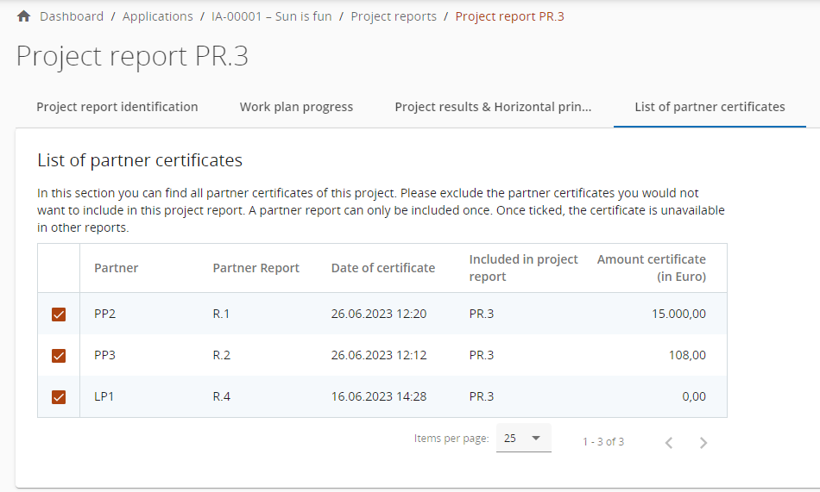
    Project report - List of partner certificates
In this tab, all partner certificates of the project are listed. A certificate can only be included in one project report. Once ticked, the certificate is unavailable in other project reports.
Upon creation of a new project report, all available partner certificates, which are not yet included in any other project report, are included in the newly created project report.

Slide 17
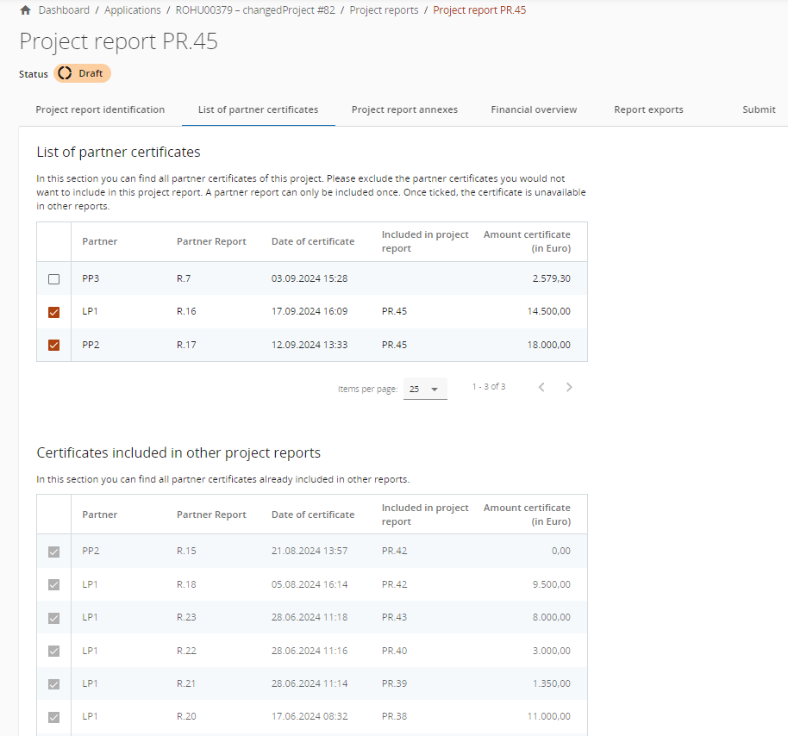
    Project report - List of partner certificates
The second list shows certificates already included in other project reports in grey color.
It is also indicated in which Project Report the certificate is included.
Useful to know is that the Project report number in the partner overview is clickable which navigates you directly to the concerned Project report.

Slide 18
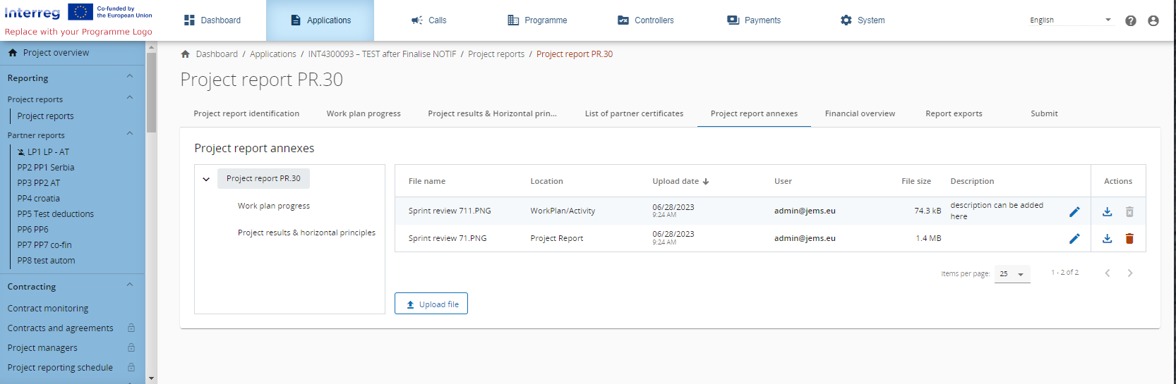
    Project report - Annexes
Similar as to partner reports, this section shows all files uploaded in the Project report.

Slide 19
    Project report - Annexes
You have the possibility to upload additional files linked to the Project report here (by clicking the Upload file button).
One of the file which is mandatory to be uploaded here is Decision of Aproval of the Project Report isued by the Joint Steering Committee of the project.
Since it is not always possible to add descriptions to files in the dedicated sections (due to the chip style upload), users with edit right are also allowed to add descriptions to all files in this section.
Files uploaded in this section can be deleted here, other files can only be deleted in the section where they were uploaded.

Slide 20
    Project report Financial overview
The project report financial overview section comes with 6 different financial overview tables.
General purpose
The financial overview tables show how the project is proceeding in terms of spending. The amounts included in the tables represent the aggregation of data from all project reports submitted by the date when the current project report was created.

Slide 21
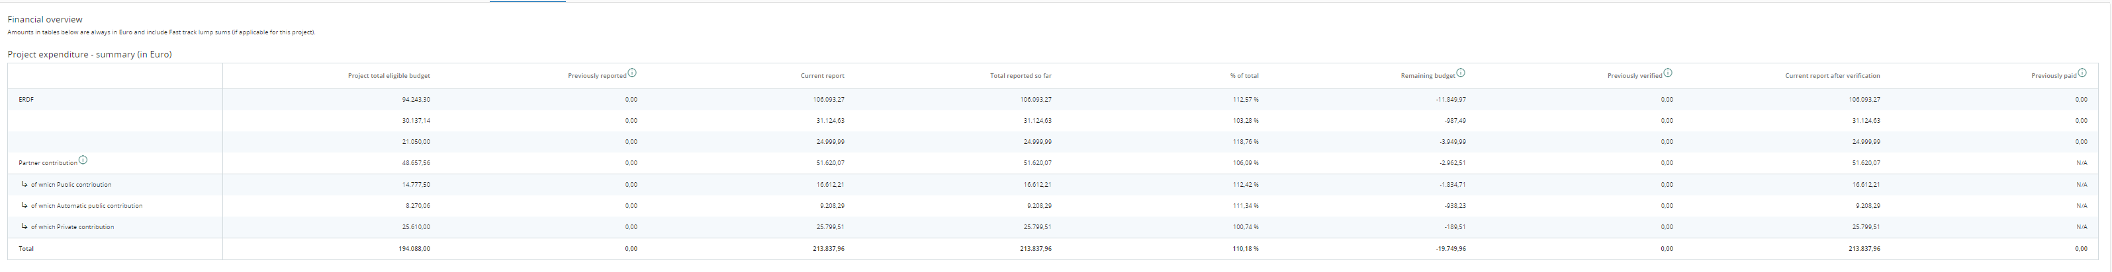
    Project report Financial overview
Project Expenditure - summary (in Euro)
This section shows the project budget - approved in application form, previously reported, current report, previously validated, previously paid - divided per fund and contribution type (public/private/automatic public) - at the moment of creation of current partner report, and also shows some calculations using figures from the table.

Slide 22
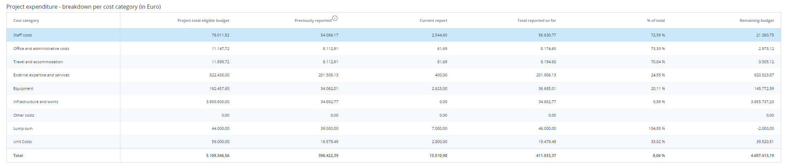
    Project report Financial overview
Project Expenditure - breakdown per cost category (in Euro)
This table shows the project budget - approved in application form, previously reported and current report - split per cost category. The table behaves quite similar as the other tables with similar columns.

Slide 23
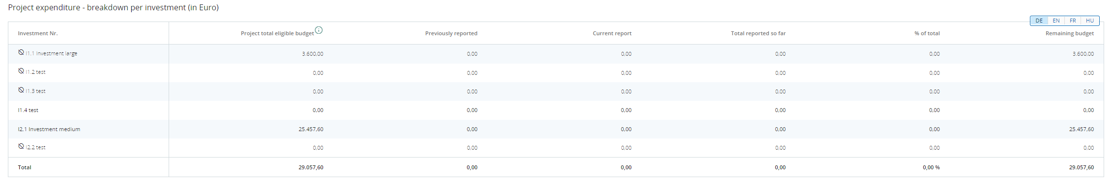
    Project report Financial overview
Project Expenditure - breakdown per investment (in Euro)
In this overview table all cost items linked to an investment are summed up.
- No Simplified cost items are added up to this table, as they are automatically calculated in previous table. Only real costs linked to the investment in the List of expenditure are displayed in this overview table.

Slide 24
    Project report Financial overview
Project Expenditure - breakdown per Lump sum (in Euro)
In our Programme Lump sums consists of Project preparation costs and Project closure cost.
In this overview table Lumps sums are presented.

Slide 25
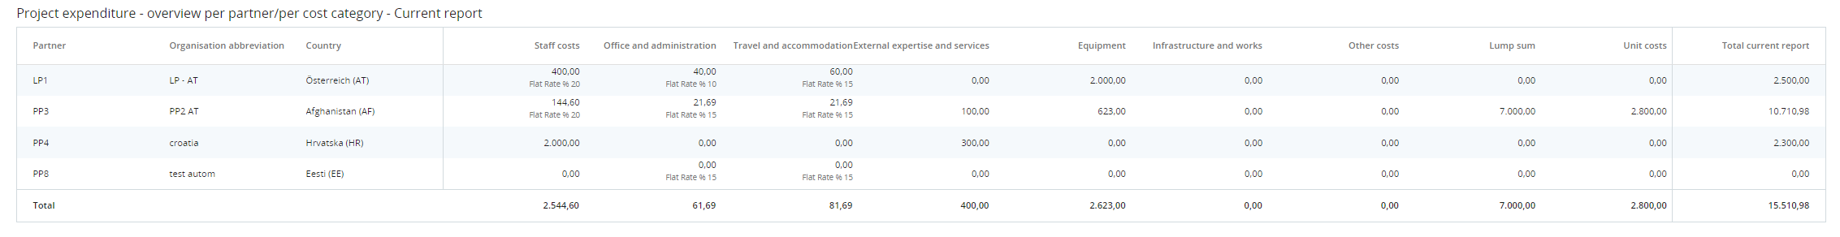
    Project report Financial overview
Project expenditure - overview per partner/per cost category - Current report
This table shows the values per partner per cost category only from the Current report.

Slide 26
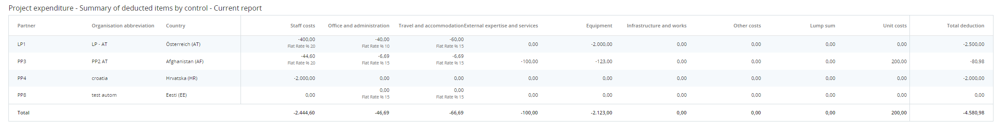
    Project report Financial overview
Project expenditure - Summary of deducted items by control - Current report
This table sums up all deductions carried out by control per partner and type of error. These values are not cumulative but only related to the certificates included in this report.

Slide 27
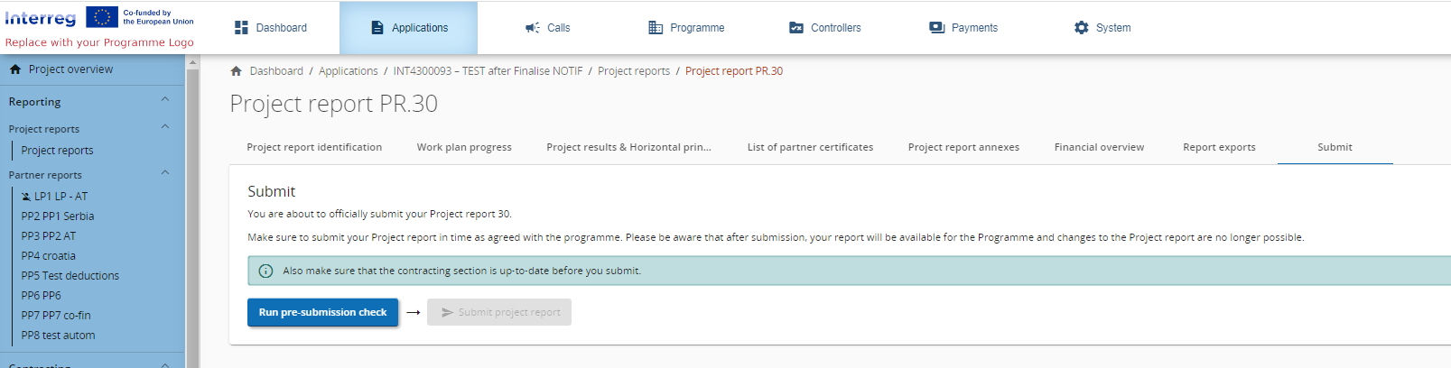
    Project report - Export
In this section you can export Project report in PDF format.
    Project report - Submit
In this section the project report can be submitted. After submission, the project report is frozen and the MA/JS verification can be started.

Slide 28
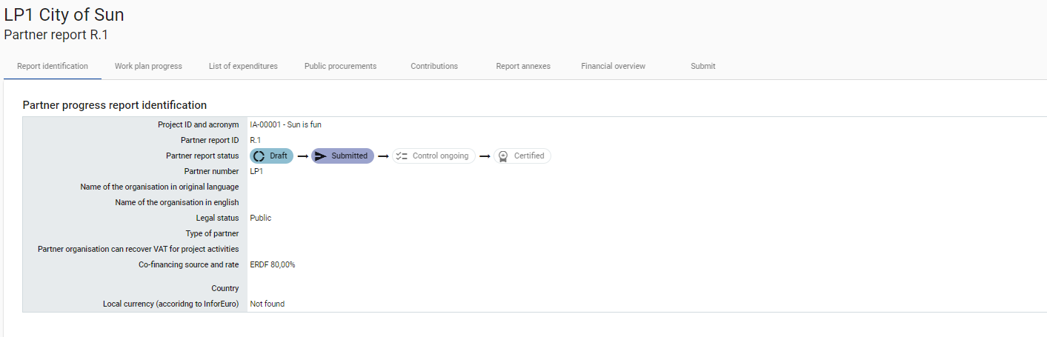
    Additional information
A general warning is given to partners that they are reminded to make sure that the contracting section is up to date.
This is to make sure that the bank details and other information in the contracting section and the dedicated partner pages stay up to date.
Once submitted, the status of the report changes.

Slide 29

Thank you!
Contact
Tel: +40 356.426.360
Fax: +40 356.426.361
E-mail: ipacbc@brct-timisoara.ro
Website: www.romania-serbia.net
Joint Secretariat: BRCT Timişoara Str. Proclamaţia de la Timisoara nr. 5, 300054, Timișoara, Romania

