Slide 1
Interreg IPA
Romania-Serbia Programme
Reporting in Jems – Partner Report

Slide 2
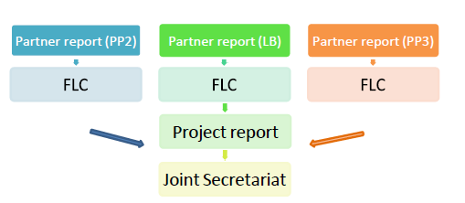
Reporting process:
Step 1 - Each partner has to fill in and submit his own report to the FLC in Jems;
Step 2 - First Level Controllers (FLC) will verify the reports and certify the expenditures in the system;
Step 3 - The Lead Partner (LP) will prepare a consolidated project report, include the FLC certificates of the partners and submit it to Joint Secretariat (JS).

Slide 3
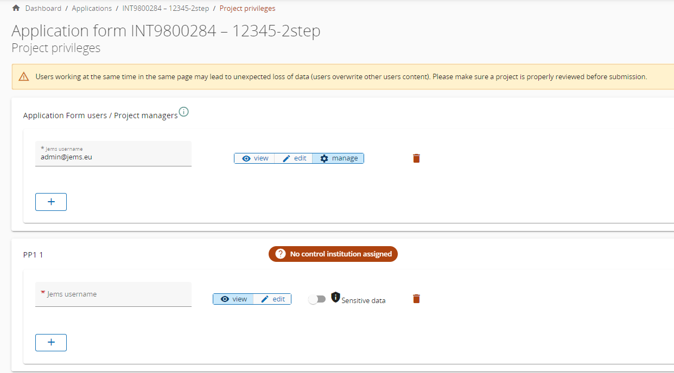
PARTNER REPORT in Jems
In order for a partner to access the reporting section, the Lead Partner has to assign a user in the Project privileges section to a partner recorded in the Application Form.
Only users assigned to a Project Partner (PP) are allowed to create and submit reports for partner reports.
In Jems, all the reports that have not been “Submitted” to FLC are deleted in case any Modification Request is asked by LP or JS!

Slide 4
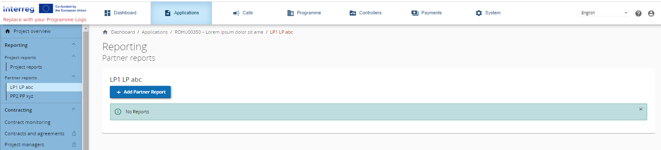
Create Partner Report in Jems
For creating a new Partner Report, you need to click “+Add partner report” under the table displaying an overview of partner reports.
The Lead partners must create their own partner reports as “PP” role, not as “LP” role. The LP role is exclusively for creating Project reports.

Slide 5
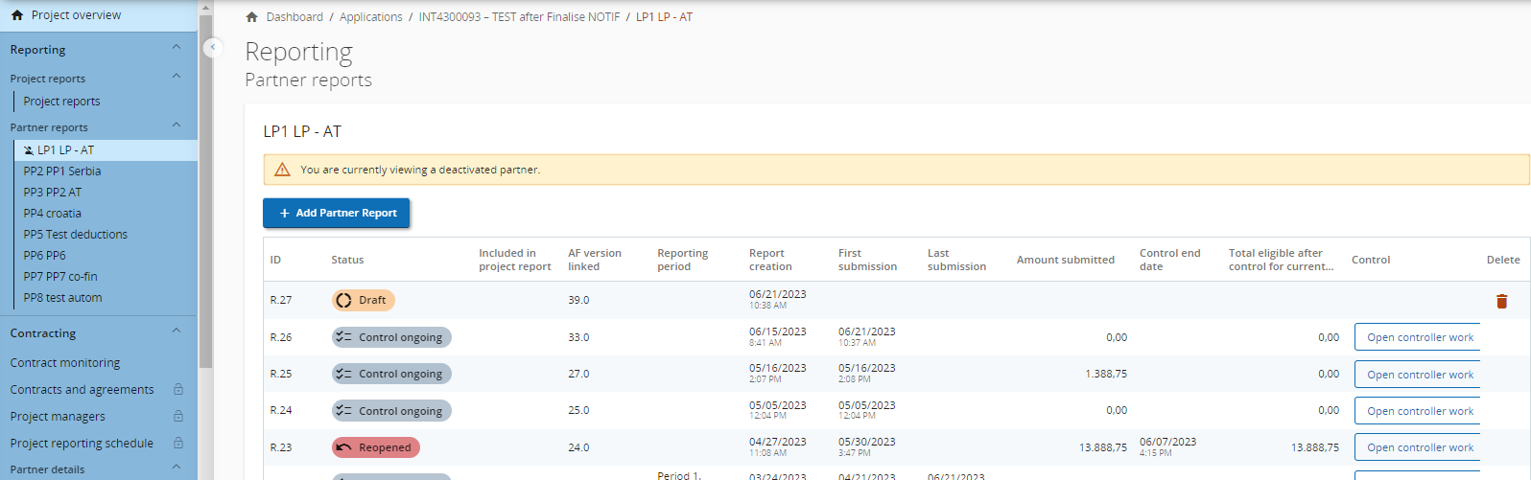
Partner Report in Jems
When the “+Add partner report” button is clicked the partner report is generated. Important to note is that the data from the last approved application form version is taken into the partner report in the moment of its creation. Ongoing modifications will have no impact on the data in existing reports.
Multiple partner reports can be created. There are no restrictions for the number of reports created. However, partner report creation is not possible while last partner report in in status Reopened.
When reports are created, they can be accessed via the overview table as shown below.

Slide 6
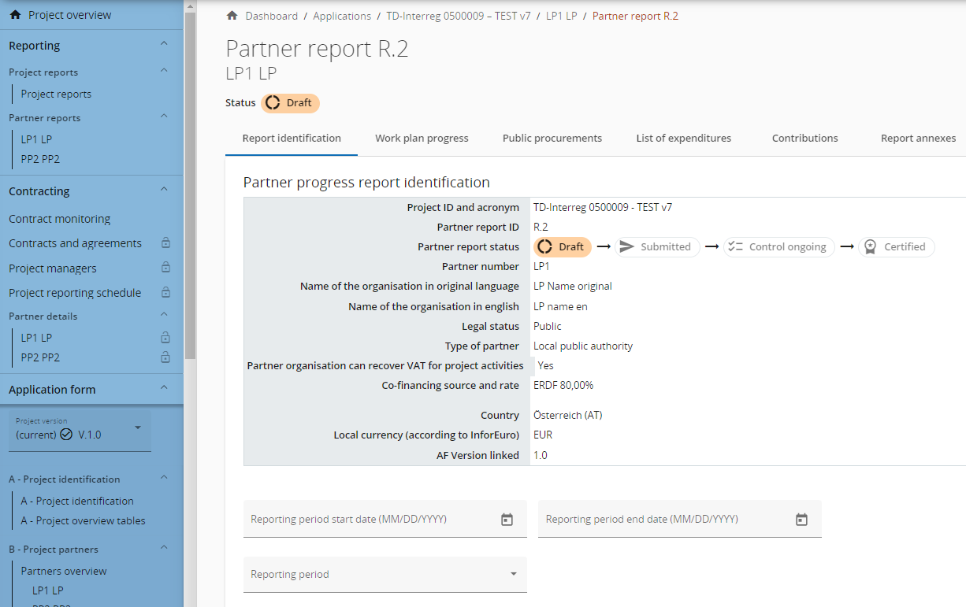
Partner report identification
    When creating a report you will land automatically on the first tab called Partner report identification.
    The top table provides you some basic data retrieved from the last approved Application Form. What is interesting to mention is that, based on the country of the Partner's main address, the Local currency is also automatically added to the overview table.
    You just continue filling in other fields on this section.
The user should save any information recorded in the Jems after each operation made by pressing the “SAVE”

Slide 7
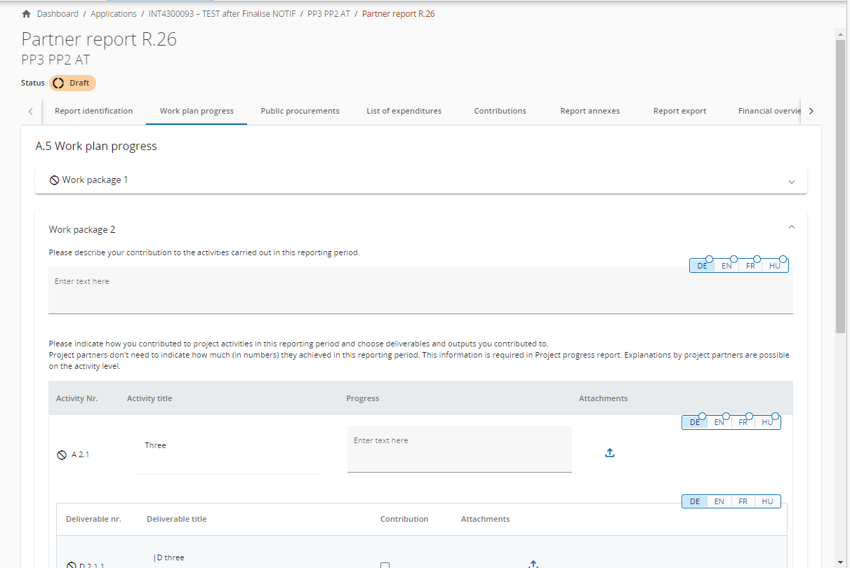
Partner report -Work plan progress
The second tab, work plan progress, takes the work plan related data from the last approved application form, organized per work package:
Partners describe the progress on certain work packages, objectives, Investments, activities, deliverables and outputs and indicate if they contributed. (Later, at project report level the Lead partner shall fill in values achieved).
Partner users can also upload an attachment per item which will show up again in the partner report Annexes.

Slide 8
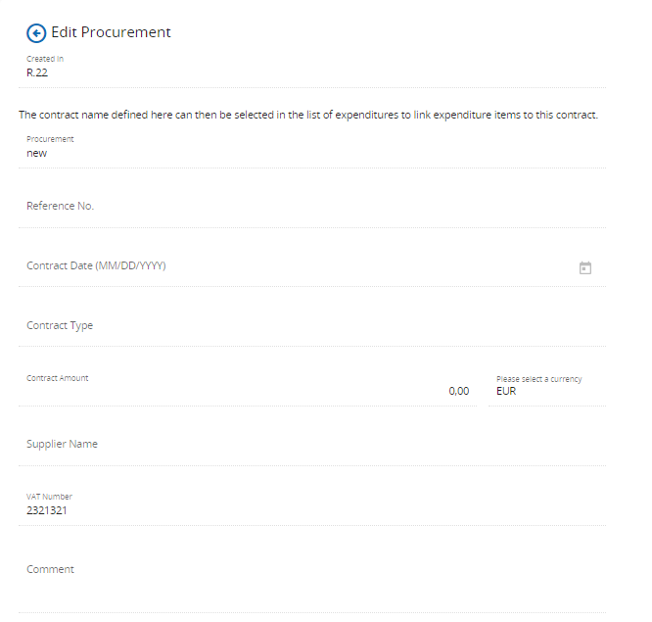
Partner report – Public Procurements
    The section has a “+ Add procurement” button which opens the procurement for filling in details, and an overview list with details of the procurements already created.
    The section with procurement details has the following fields:
Note that the Contract Name, VAT and Currency are mandatory.
The Contract Name shall be reused in the List of expenditure. It is therefore important that the partner provides a distinct name, so that the procurement can be easily identified in the List of Expenditure.
All procurement detail from above can be edited only in the partner report where procurement was created, while report is in status Draft. After submission, fields are locked for editing.
Procurements can be updated after by simply clicking the +Add procurement update button;

Slide 9
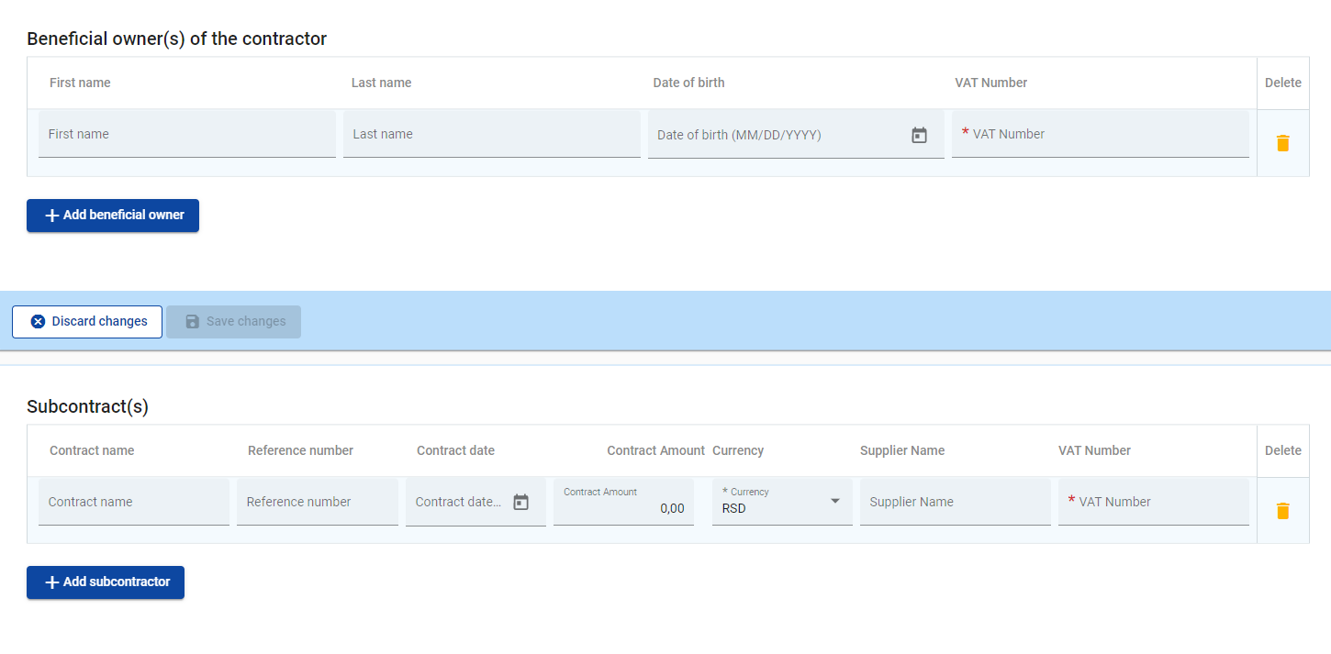
Partner report – Public Procurements
Beneficial owners and subcontractors
In the EC Regulation it is requested that beneficial owners and subcontracts are listed in the procurements section. Therefore, Jems provides the possibility to add these data to the partner report.
Beneficial owner(s) and subcontractors can be added in any draft partner report after procurement was created, but items added in previously submitted partner reports are locked for editing/deletion.

Slide 10
Partner report – Public Procurements
Attachments
Procurement related attachments can also be added in this section. Attachments can be added in any draft partner report after procurement was created, but uploads from previously submitted reports are locked for editing/deletion.
GDPR sensitive data can be uploaded in section GDPR Attachment(s). Visibility of this section can be configured in Project privileges. A user without privilege to view sensitive data cannot download a file in this section and can also not see File name and Description.
The user should save any information recorded in Jems after each operation made by pressing the “SAVE”!

Slide 11
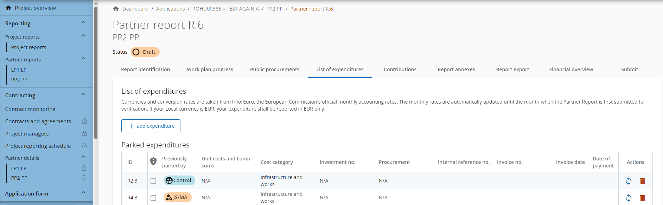
    List of Expenditures
    The list of expenditure section is the place where partners list incurred costs in original currency. When first coming to this section, it looks as below. By clicking the +add expenditure button, the partner can add expenditure items, one by one
The user should save any information recorded in Jems after each operation made by pressing the “SAVE”!

Slide 12
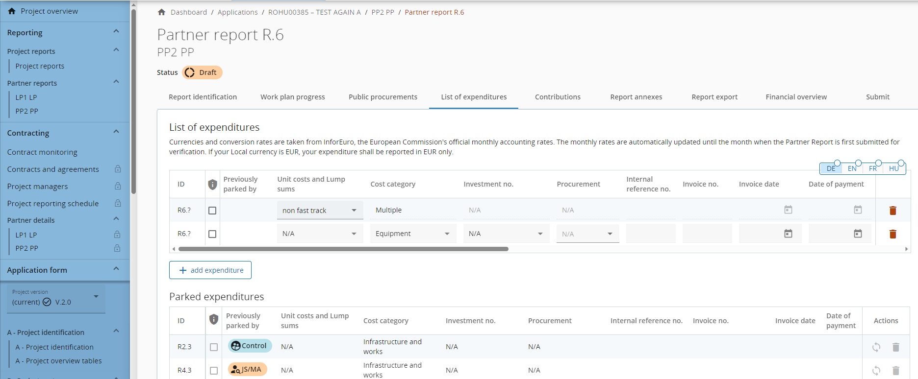
    When adding an expenditure item, the options columns available in the Application Form are showing up.
The user should save any information recorded in Jems after each operation made by pressing the “SAVE”!

Slide 13
Input fields
ID
This running number is always in the format R[report number].X. The ID is dynamic in draft status (reports created have seamless consecutive numbering, even if a report is deleted), however it will be frozen upon submission of the report. The number will be used later on to identify cost items coming from another (previous) report (through parking of expenditure).
GDPR flag
Partner user with privilege Sensitive data set to active in Project privileges can flag expenditure items that are GDPR sensitive. In this case, users without Sensitive data privilege active will not be able to see Description, Comment and Attachment.
Previously parked by
Displays either Control or JS/MA - depending on the level of verification where the item was last parked, namely control of partner report or verification of project report. An item shall keep it’s label throughout the system.

Slide 14
Cost category
This field links the cost item to a cost category. Cost categories available in the Application form budget can be selected here. If cost categories are switched off in the call settings, they will also not show up in the list of expenditure.
Investment No.
This field links expenditure to investment items in the Application Form, if the project has investments. If the project has no investments this field is hidden in the report.
Procurement
This field is used to link expenditure to public procurements (for more info see Partner report procurement). All contract names created by the partner in the public procurement section show up here.
Internal reference no. & Invoice no.
These input fields can be used to identify the expenditure.
Invoice Date & Date of Payment
Dates to be entered by the partner.

Slide 15
Description & Comment
Here the partner can provide further justification on the cost item. In the Comment section add the Activity which cost is linked to.
Total invoice value & VAT
Here the partner can add the invoice value and VAT value. Also a negative amount can be entered as Total invoice value by entering a “-” after the number has been entered.
Declared amount
The Declared amount is based on Total invoice value and VAT. It is the value the partner claims as basis for reimbursement, i.e. this amount will be checked by the controller for eligibility. If in foreign currency, this value is the basis for calculation of the Declared amount in EUR.
Currency & Conversion rate & Declared amount in EUR
The currency field is the only input field of these 3 fields. The other fields are automatically calculated. Exchange rates are applied when expenditure items in other currencies than Euro are declared. If a report is in draft, exchange rates are updated constantly. Once a report is submitted, the exchange rates shall be taken from the month of submission and frozen.
Attachments
Upon creation of an expenditure item it is not possible to add attachments. After the item has been saved for the first time, one file can be uploaded to each item.

Slide 16
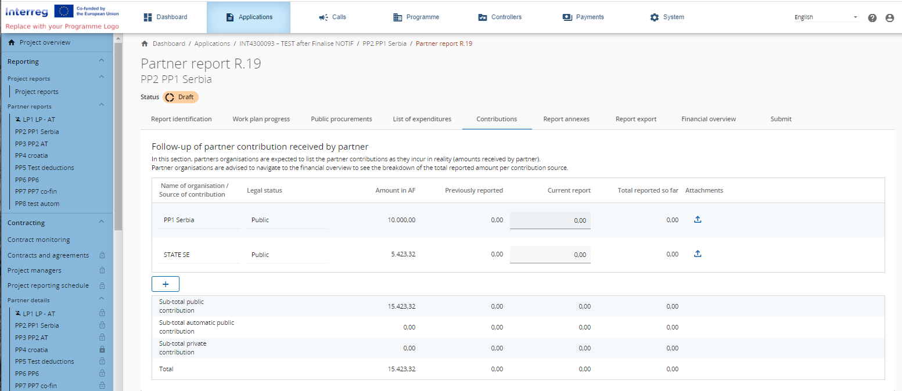
    Partner report -Contribution
Contributions section is the place where partners should follow-up partner contributions they received. This is a cumulative section, which records amounts received per report and adds them up in next reports.
The user should save any information recorded in Jems after each operation made by pressing the “SAVE”!

Slide 17
The Source of contributions from the last approved Application form is automatically displayed on this page. The first row is always the partner organisation’s own contribution.
A partner can also add Sources of contributions by clicking the “+” button which will add a row, allowing them to indicate new contributions received.
For each Source of contribution an amount can be entered in the column Current report. For negative amounts, a “-” has to be entered after the number has been entered.
All Sources of contribution are transferred to the next Partner report created and the amounts entered in the field Current report from all previous reports will be summed up in the field Previously reported.

Slide 18
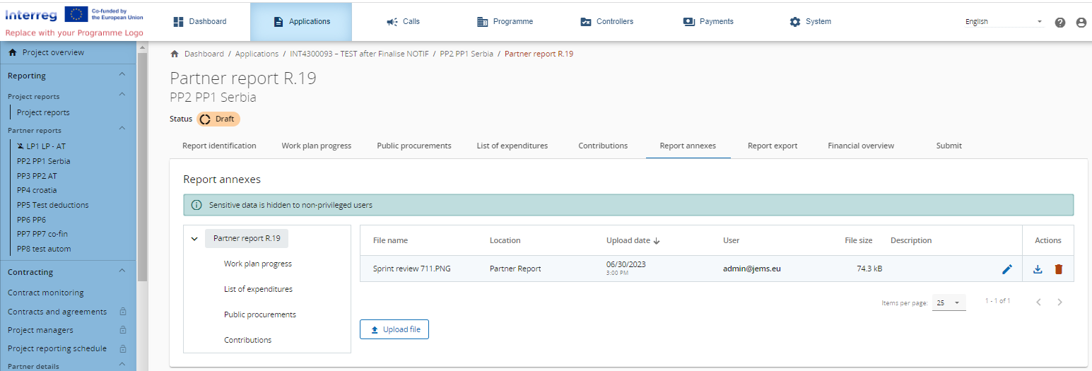
    Partner report - Annexes
This section shows all files uploaded in the partner report.
The tree structure represents the places within that report where files can be uploaded. All uploads from all sections are shown.
Partner organisations have the possibility to upload additional files.
Since it is not always possible to add descriptions to files in the dedicated sections (due to the chip style upload), users with edit right are also allowed to add descriptions in this section.
Files uploaded in this section can be deleted here.

Slide 19
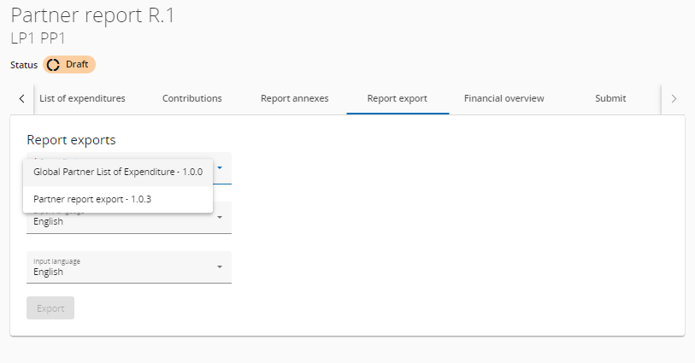
    Partner report - Export
In this section you can export Partner report export in PDF format or Global Partner List of Expenditure in Microsoft Excel format.

Slide 20
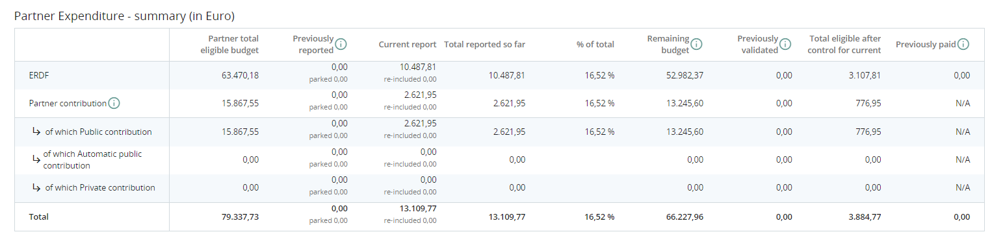
    Partner report-Financial overview
The partner report financial overview section comes with 5 different financial overview tables.
Partner Expenditure - summary (in Euro)
This section shows the partner budget - approved in application form, previously reported, current report, previously validated, previously paid - divided per fund and contribution type (public/private/automatic public) - at the moment of creation of current partner report, and also shows some calculations using figures from the table.

Slide 21
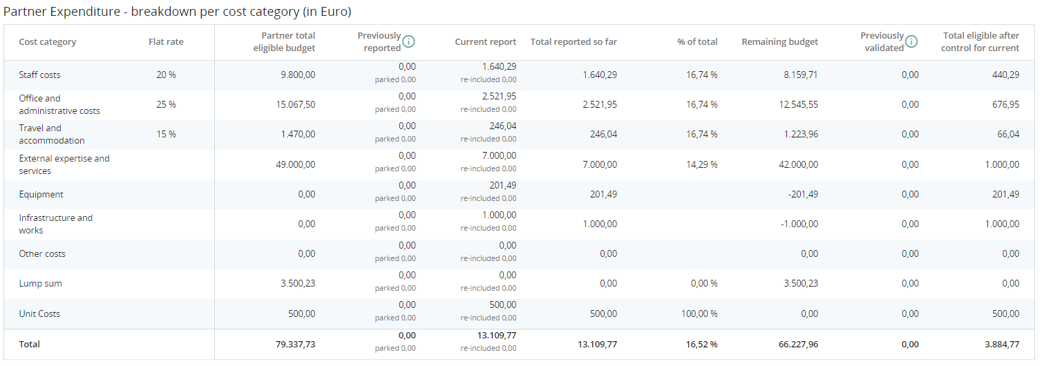
Partner Expenditure - breakdown per cost category (in Euro)
This table shows the partner budget - approved in application form, previously reported and current report - split per cost category. The table behaves quite similar as the other tables with similar columns.
There are however a few unique elements that are important to note in regard to the Simplified Cost Options:
Flat rates;
Lump sums & unit costs;
Unit costs covering single cost categories.

Slide 22
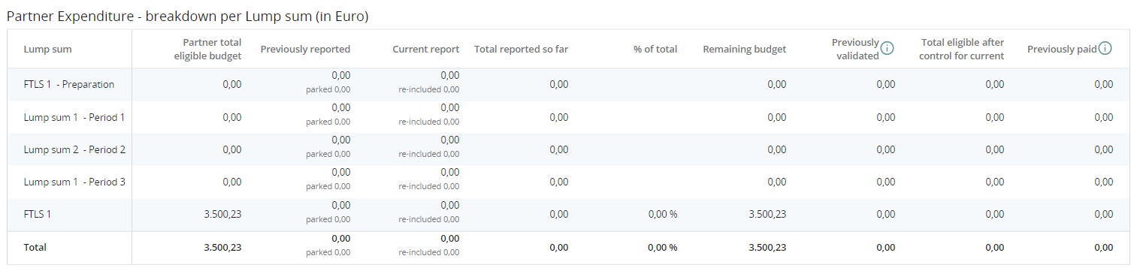
Partner Expenditure - breakdown per Lump sum (in Euro)
This table shows the Lump sums and their partner share. Lump sums declared in the list of expenditure show up in the Current report column.
At the end, this table shows which lump sums are approved in Application Form and which are already reported.

Slide 23
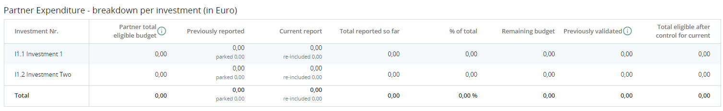
Partner Expenditure - breakdown per investment (in Euro)
In this overview table all cost items linked to an investment are summed up.
What is important to note is what is described in the info bubble: no Simplified cost items are added up to this table, as they are automatically calculated on top. Only real costs linked to the investment in the List of expenditure are displayed in this overview table.

Slide 24
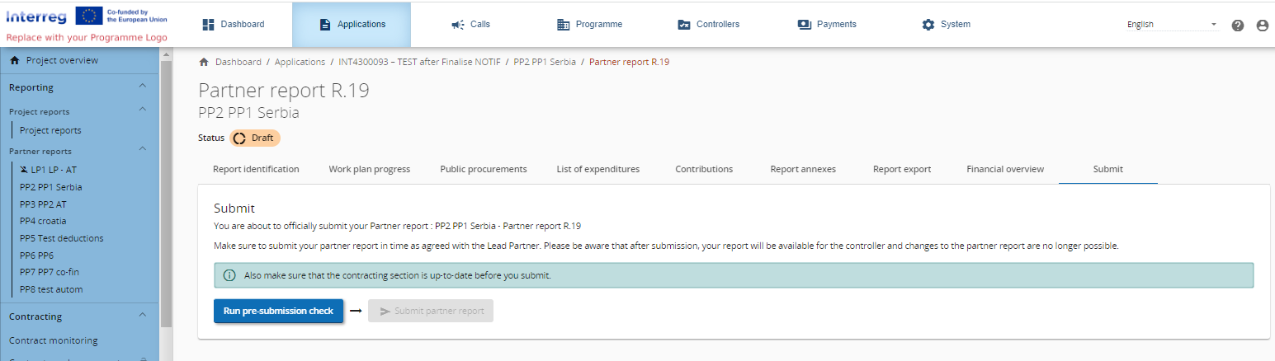
    Partner report - Submit
In this section the partner report can be submitted. After submission, the partner report is frozen and the control work can be started.

Slide 25

Thank you!
Contact
Tel: +40 356.426.360
Fax: +40 356.426.361
E-mail: ipacbc@brct-timisoara.ro
Website: www.romania-serbia.net
Joint Secretariat: BRCT Timişoara Str. Proclamaţia de la Timisoara nr. 5, 300054, Timișoara, Romania

