Slide 1



Interreg IPA
Romania-Serbia Programme
Specific rules for communication activities

Slide 2

Common rules apply for all project partners.
The Visual Identity Manual (VIM) and the Programme logo are available on: www.romania-serbia.net
Project partners must promote the results and benefits of their projects to relevant groups or to the general public, using plain language and the Programme logo.

Slide 3
Legal Requirement:
The Lead Partner shall ensure that communication and visibility materials realized by the project are made available upon request to programme bodies, European Union institutions, bodies, offices or agencies and that a royalty-free, non-exclusive and irrevocable license to use such material and any pre-existing rights attached to it is granted to the European Union.
(CPR Regulation 2021/1060 Annex IX point 2)

Slide 4
Communicator
Information and publicity measures
person responsible at project level
mandatory use for all projects
inform the JS when you promote your project
Durable plaques or billboards
Programme logo
mandatory use on all communication materials

Slide 5
Programme name used for communication purposes:
Interreg IPA Romania-Serbia Programme
Programul Interreg IPA România-Serbia
Interreg IPA program Rumuniјa-Srbiјa
Интеррег ИПА програм Румунија-Србија

Slide 6
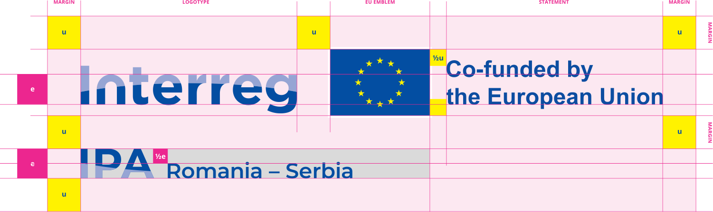
Programme logo
The Programme logo must be used on
all communication materials, preferably the colour version on white background.
The EU emblem must be at least the same size as the biggest of the other logos.

Slide 7




Language variations
English
Romanian
Serbian Cyrillic
Serbian Latin

Slide 8

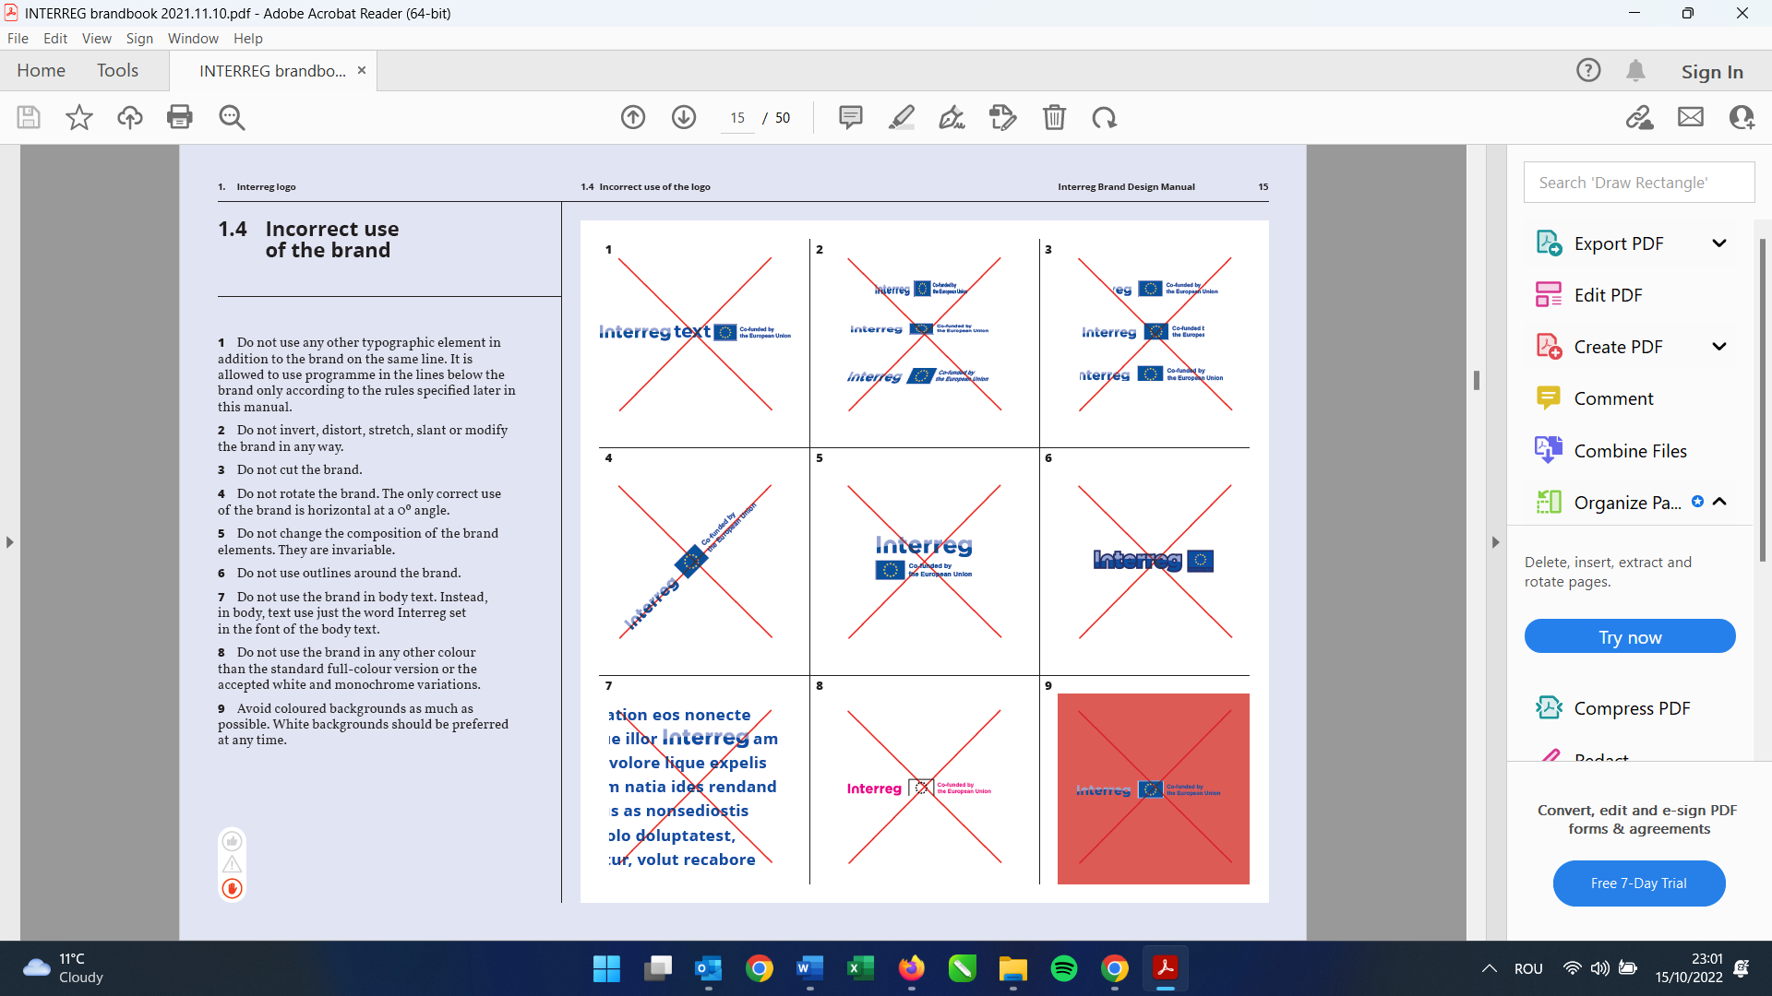
Incorrect use of the logo
Do not use the 2014-2020 Programme logo.
Do not use any other typographic element in addition to the Programme logo.
Do not invert, distort, stretch, slant or modify the logo in any way.
Do not cut the logo.
Do not rotate the logo. The only correct use of the brand is horizontal at a 0º angle.
Do not change the composition of the brand elements. They are invariable.
Do not use outlines around the brand logo.
Do not use the brand in body text.
Do not use the brand in any other colour than the standard full-colour version or the accepted white and monochrome variations.
Avoid coloured backgrounds as much as possible. White backgrounds should be preferred at any time.

Slide 9








Priority Icons
Priority 1: Environmental protection and risk management
Priority 2: Social and economic development

Slide 10
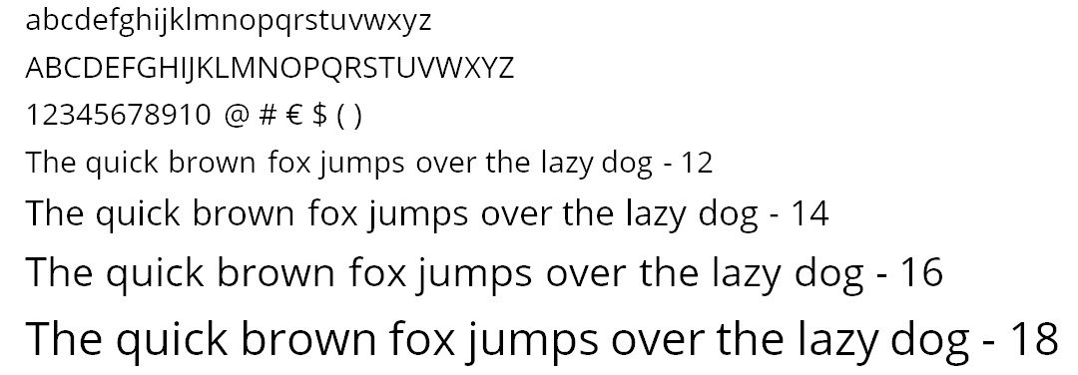
Typography / Fonts
Open Sans is the recommended font. Contains all styles: regular, bold and italic.
As an alternative to Open Sans: Vollkorn. Other suggested fonts: in VIM.
Avoid unusual or bizarre fonts, unless the target audience fits with your choice.

Slide 11
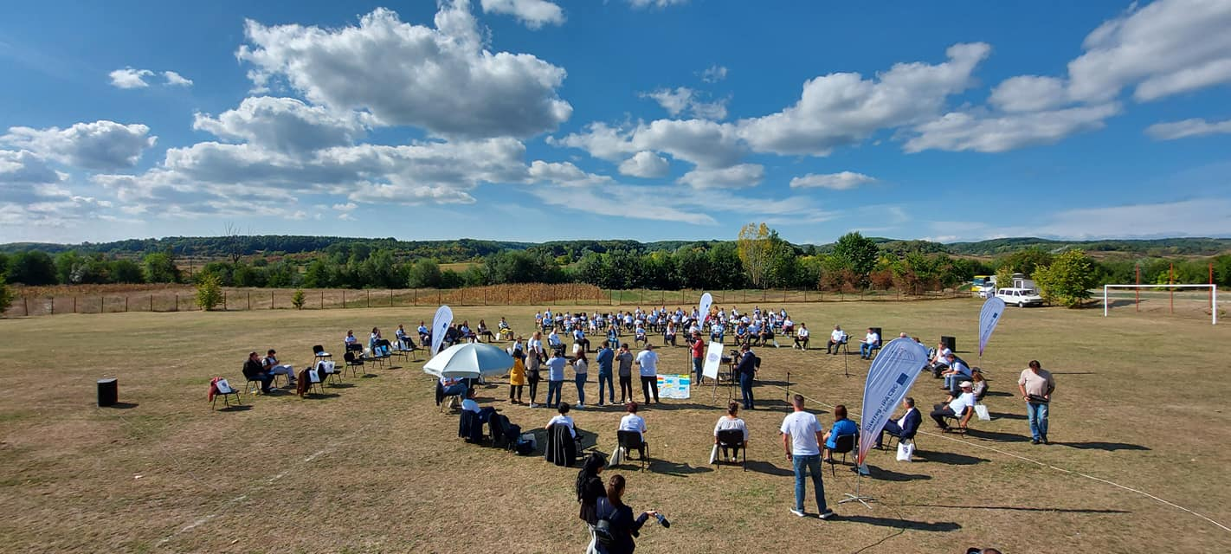
Use photos and mention the copyright holder!
©ROCBC Timisoara

Slide 12



Social media
Primary hashtags:
#Interreg #InterregIPA #RomaniaSerbia
#RORS00000
#CohesionPolicy
#EUinmyRegion
#EUfunded
For the Programme facebook page use @ipacbcrose to link to the Programme.
For the Programme X (twitter) page: @IPACBCRORS
For the Programme Instagram page: @ipacbcrors

Slide 13
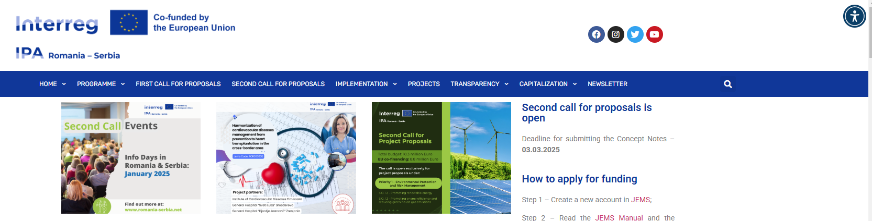
Website
Each partner shall provide on the partner’s official website or social media sites, where such sites exist, a short description of the project, including its aims and results, and highlighting the EU financial support by using the Programme logo.
Good practice: display the Programme logo inside the viewing area of digital devices, without requiring the user to scroll down the page.
Use accessibility plug-ins.

Slide 14
Accessibility
Ensure access for people with disabilities
Identify effective channels for promotion
Know your audience
Design compatible content online:
ensure that webpages work on all platforms and browsers;
format information so it displays adequately on all devices, including smart phones and tablets;
keep most file sizes small so users with slow internet connection can still have access to content;
create links to large files, rather than embedding them in a webpage, so users can retrieve them if they have access to more bandwidth.

Slide 15
Programme website
Include a link to the Programme website in your
communication materials/ own website/ own social media.
www.romania-serbia.net

Slide 16

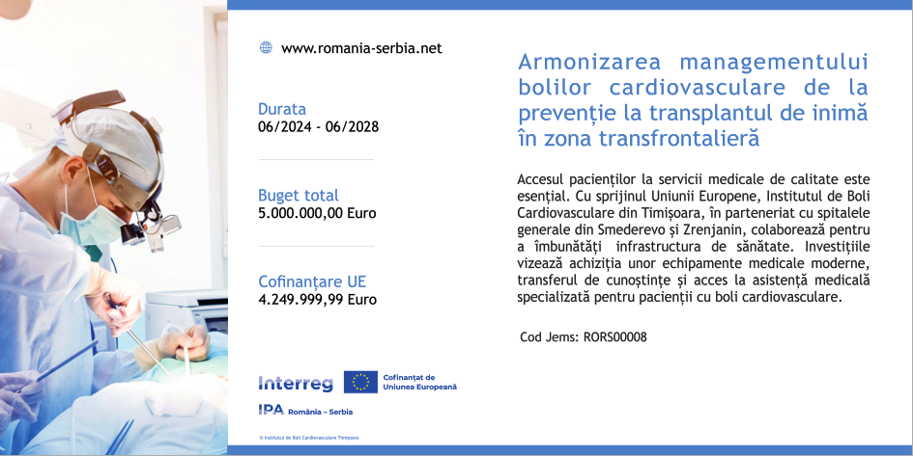
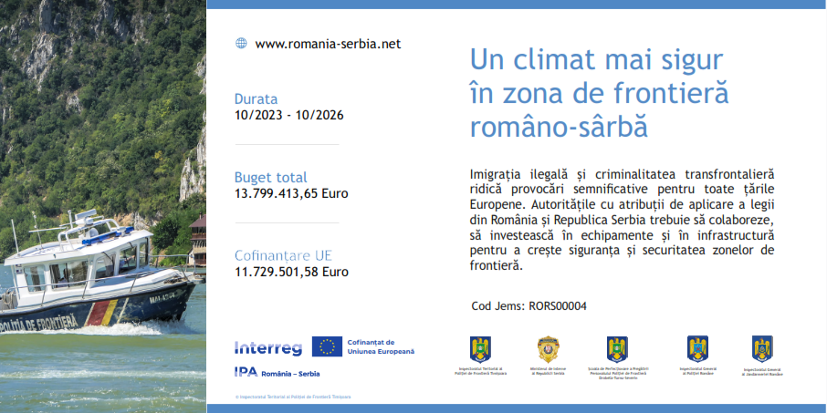
Durable plaques or billboards
visible to the public,
include the Programme logo as soon as the physical implementation of operations involving physical investment starts or purchased equipment is installed,
prepare a high quality photo relevant to your project and a short description and send it by e-mail to dani.bardos@brct-timisoara.ro and the JS project manager assigned to your project, to work together on the template.

Slide 17
Promotional items
Take a minute to consider their impact environmentally, socially and economically:
choose items that are needed and have a high use value.
choose products and production sites nearby, local.
go for durable, environmentally friendly materials.
choose reusable items and designs, e.g. banners or roll-ups without specific dates, to make them flexible.
Use the Programme* logo on promotional items.
* Very Small Promotional Item: use the European Union emblem + Co-funded by the European Union.

Slide 18
Publications
Include the Programme logo on the first and last covers +
Include the technical section on the last cover:
Project title and Jems code: ...
Material editor/Responsible for publication (usually the project partner): ...
Contact details of the project partner who ordered and paid for the material i.e. the material editor (e-mail / phone / website of the material editor etc.) ...
Publishing date: ...
The responsibility for the content of this material is that of the author(s). The content of this material does not necessarily represent the official position of the European Union.
Reproduction is authorised provided the source is acknowledged and any changes are indicated.
In case of any complaints, contact: romania-serbia@mdlpa.gov.ro
www.romania-serbia.net

Slide 19
Press release
Answer these questions when writing the press release:
Who? Who is involved? Who does it benefit?
What? What is new?
Why? Why is this important news?
Where? Where is this happening?
When?
How?
Use the journalistic style of writing: friendly, direct, creative, active voice, avoid jargon.
Include the Programme logo and your contact details.

Slide 20
Vehicle panels /Self-Adhesives /Stickers /Tags
The minimum recommended size of the panel for all vehicles (cars, trucks, special utility vehicles, vans etc.) is A4.
If the design of the vehicle does not permit it, please consult the MA/JS for an alternative solution.
Templates are available on the Programme site.
Equipment, furniture and other purchased items must bear a self-adhesive or a tag, depending on the material, in a visible place.
Size may vary.
Templates are available on the Programme site.

Slide 21
General Advice
Use plain language
Use familiar words
Tell stories, build a conversation
Make it visual
Listen to your audience
Call your audience to action (Join! See! Do!)
Ensure accessibility
Coordinate with partners
Be transparent
Be technically accurate
Communicate when you have something relevant to say
Promote European Union co-funding

Slide 22
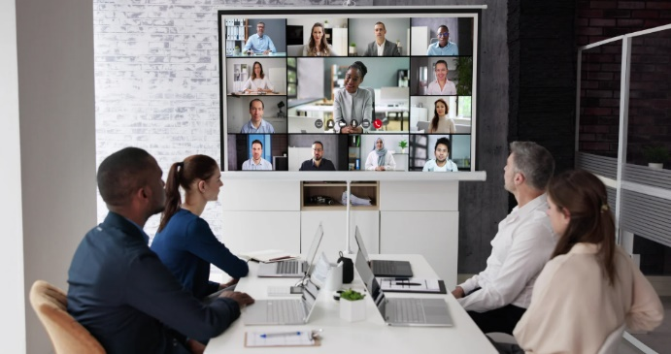

Green communication tips
Online communication
Paperless and digitalisation
Go local!
0% plastic waste

Slide 23
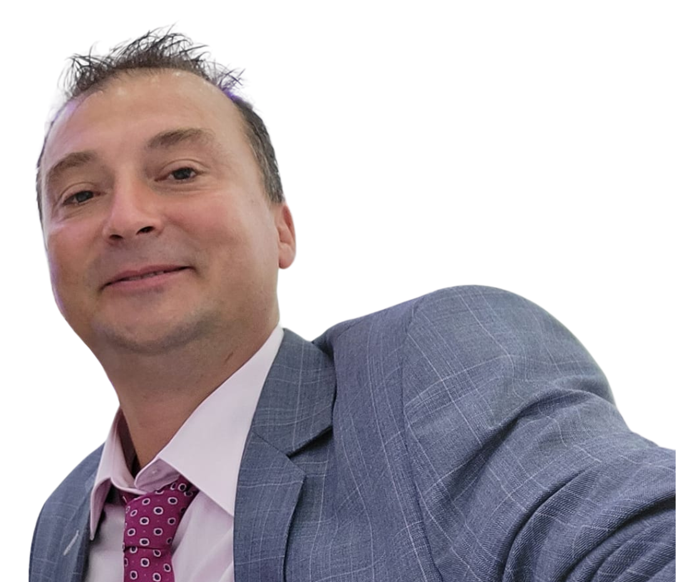
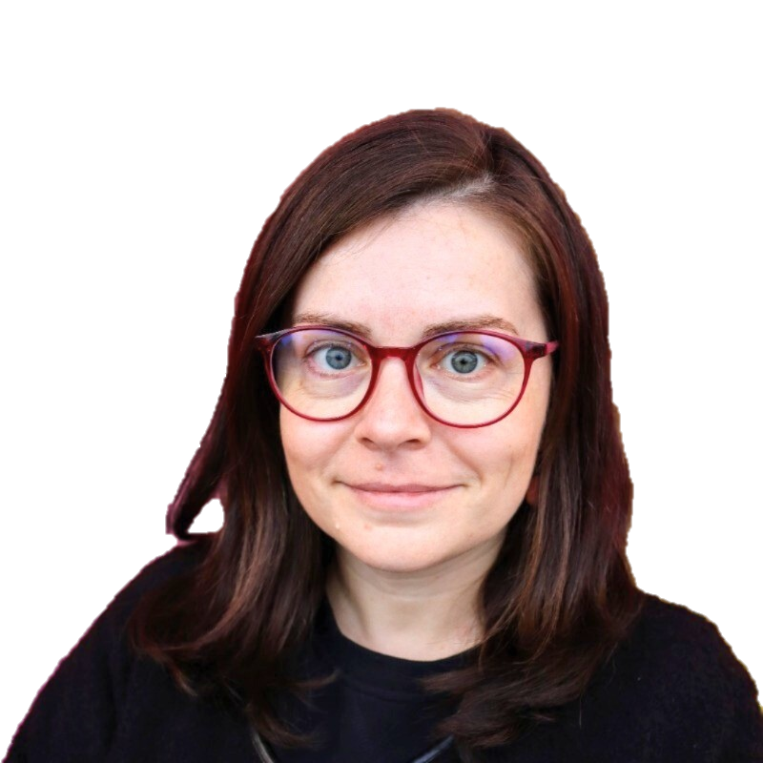
Contact info: visibility and communication
carmen.stojanovic@brct-timisoara.ro
dani.bardos@brct-timisoara.ro

