Slide 1
INTERREG IPA ROMANIA-SERBIA PROGRAMME
Visual Identity &
Communication Guide
Clear, concise rules and guidelines to help project partners achieve professional compliance and high publicity impact.

Slide 2
Core principles &
Legal Mandates
Lead Partners hold ultimate project-level accountability, but ALL PARTNERS must deliver the visibility actions planned in their applications and required by the Regulations.
Project partners must promote the results and benefits of their projects to relevant groups or to the general public, using plain language and the Programme logo.
Use the mandatory Visual Identity Manual (VIM) and the Programme logo which are updated and available on: www.romania-serbia.net
Failure to meet EU transparency and public information regulations carries direct financial consequences: a lack of remedial action on visibility can lead to the MA cancelling up to 2% of your grant.

Slide 3
Core principles &
Legal Mandates
The Lead Partner shall ensure that communication and visibility materials realized by the project are made available upon request to programme bodies, European Union institutions, bodies, offices or agencies and that a royalty-free, non-exclusive and irrevocable license to use such material and any pre-existing rights attached to it is granted to the European Union.
(CPR Regulation 2021/1060 Annex IX point 2)

Slide 4
Programme name used for communication purposes:
Programme name
Interreg IPA Romania-Serbia Programme
Programul Interreg IPA România-Serbia
Interreg IPA program Rumuniјa-Srbiјa
Интеррег ИПА програм Румунија-Србија

Slide 5
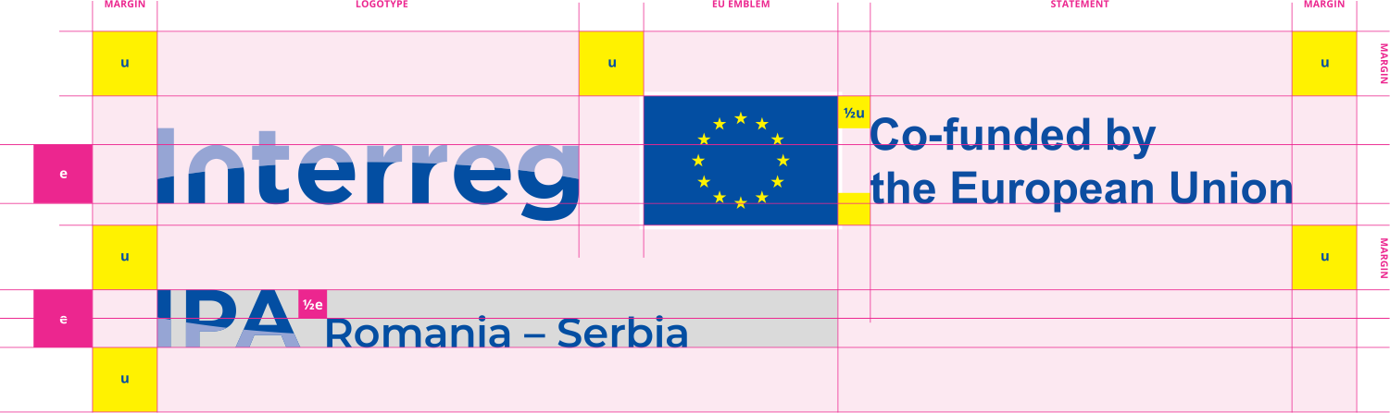
Programme logo
The Programme logo must be used on
all communication materials,
preferably the colour version
on white background.
The EU emblem (flag) within the Programme logo must be at least the same size as the biggest of the other partner logos.

Slide 6




Language variations
English
Romanian
Serbian Cyrillic
Serbian Latin

Slide 7




Priority Icon for
2nd Call projects
Priority 1: Environmental protection and risk management
HEX: #9ACA3C
CMYK: 48/0/89/0
RGB: 154/202/60

Slide 8
Programme website
Include a link to the Programme website in your
communication materials/ own website/ own social media.
www.romania-serbia.net

Slide 9
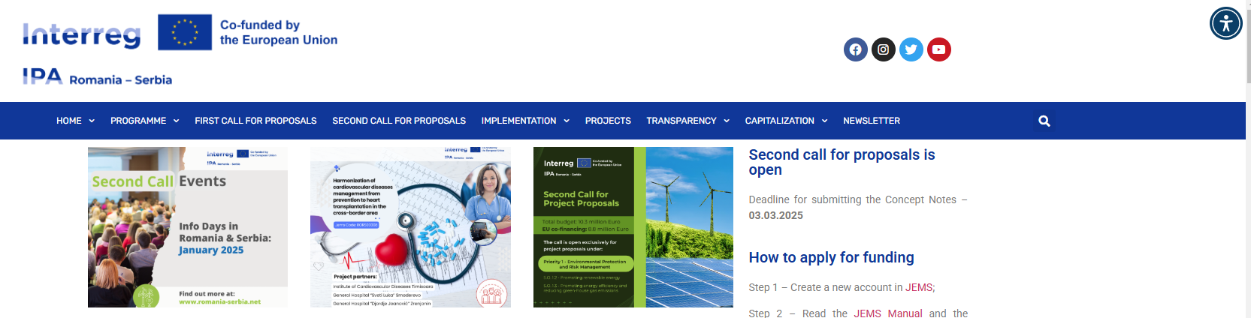
Partner Website
Each partner shall provide on the partner’s official website (or social media pages), where such sites exist, a short description of the project, including its aims and results, and highlighting the EU financial support by using the Programme logo.
Good practice: display the Programme logo inside the viewing area of digital devices, without requiring the user to scroll down the page.
Use accessibility plug-ins.

Slide 10
Accessibility
Ensure access for people with disabilities
Identify effective channels for promotion
Know your audience
Design compatible content online:
ensure that webpages work on all platforms and browsers;
format information so it displays adequately on all devices, including smart phones and tablets;
keep most file sizes small so users with slow internet connection can still have access to content;
create links to large files, rather than embedding them in a webpage, so users can retrieve them if they have access to more bandwidth.

Slide 11



Social media
Primary hashtags:
#Interreg #InterregIPA #RomaniaSerbia
#RORS00000
#CohesionPolicy
#EUinmyRegion
#EUfunded
For the Programme facebook page use @ipacbcrose to link to the Programme.
For the Programme X (twitter) page: @IPACBCRORS
For the Programme Instagram page: @ipacbcrors

Slide 12

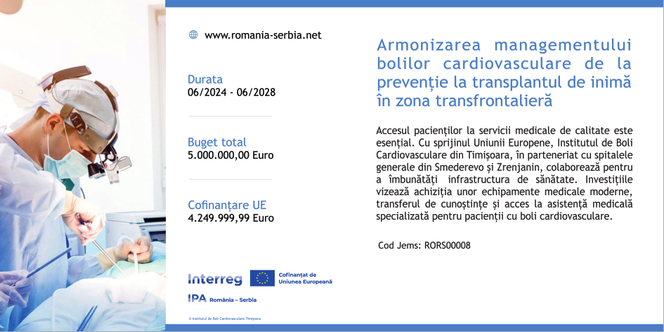
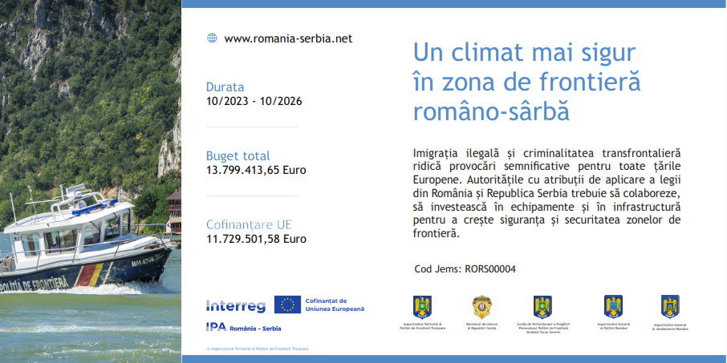
Durable plaques or billboards
MANDATORY & visible to the public,
include the Programme logo as soon as the physical implementation of operations involving physical investment starts or purchased equipment is installed,
prepare a high quality photo relevant to your project and a short description and send it by e-mail to dani.bardos@brct-timisoara.ro + the JS project manager assigned to your project, to work together on the template.

Slide 13
Promotional items
Take a minute to consider their impact environmentally, socially and economically:
choose items that are needed and have a high use value.
choose products and production sites nearby, local.
go for durable, environmentally friendly materials.
choose reusable items and designs, e.g. banners or roll-ups without specific dates, to make them flexible.
Use the Programme* logo on promotional items.
* Very Small Promotional Item: use the European Union emblem + Co-funded by the European Union.

Slide 14
Self-Adhesives/Stickers/Tags:
Vehicle panels:
The minimum recommended size of the panel for all vehicles (cars, trucks, special utility vehicles, vans etc.) is A4.
If the design of the vehicle does not permit it, please consult the JS/MA for an alternative solution.
Equipment, furniture and other purchased items must have a self-adhesive or a tag, the size may vary depending on the material and object, in a visible place.
!!! Templates are available on the Programme website !!!

Slide 15
Publications
Include the Programme logo on the first and last covers +
Include the technical section on the last cover:
Project title and Jems code: ...
Material editor/Responsible for publication (usually the project partner): ...
Contact details of the project partner who ordered and paid for the material i.e. the material editor (e-mail / phone / website of the material editor etc.) ...
Publishing date: ...
The responsibility for the content of this material is that of the author(s). The content of this material does not necessarily represent the official position of the European Union.
Reproduction is authorised provided the source is acknowledged and any changes are indicated.
In case of any complaints, contact: romania-serbia@mdlpa.gov.ro
www.romania-serbia.net

Slide 16
Press release
Answer these questions when writing the press release:
Who? Who is involved? Who does it benefit?
What? What is new?
Why? Why is this important news?
Where? Where is this happening?
When?
How?
Use the journalistic style of writing: friendly, direct, creative, active voice, avoid jargon.
Do not copy dry, official paragraphs directly from technical progress reports.
Instead, turn your data into human stories that highlight the real advantages and community benefits your project delivers.
Include the Programme logo & Programme name, and your contact details.

Slide 17
General Advice
Use plain language
Use familiar words
Tell stories, build a conversation
Make it visual
Listen to your audience
Call your audience to action (Join! See! Do!)
Promote European Union co-funding
Ensure accessibility
Coordinate with partners
Be transparent
Be technically accurate
Communicate when you have something relevant to say
Answer these questions:
What specific challenge is this project solving?
How does this event/investment/action benefit the local community, the cross-border community or the EU as a whole?

Slide 18
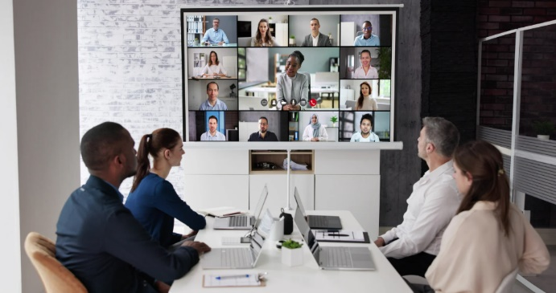

Green communication tips
Online communication
Paperless and digitalisation
Go local!
0% plastic waste

Slide 19
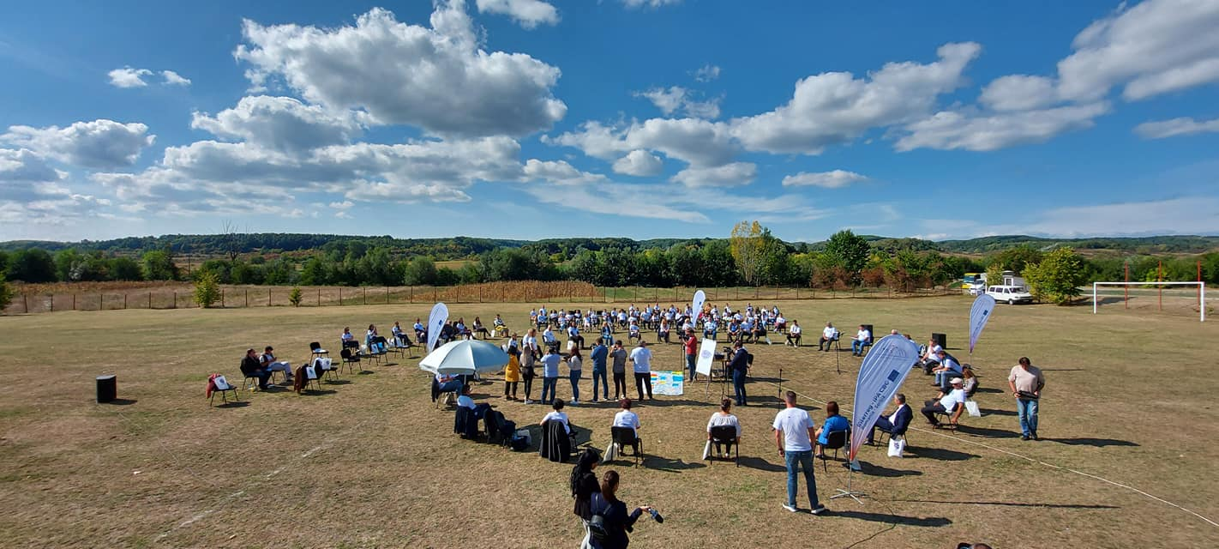
Good Visuals &
Events
Use the Programme logo on invitations & press releases, roll-ups/banners/posters, social media graphics, attendance lists for events.
Take photos & film events (it is preferable to hire a professional photographer).
Make the Programme logo visible in your photos and videos.
Use GDPR agreements (especially from parents when children appear in your photos/videos).
Mention the copyright holder in your materials.
Use attendance lists for your reporting.
Example: ©ROCBC Timisoara

Slide 20
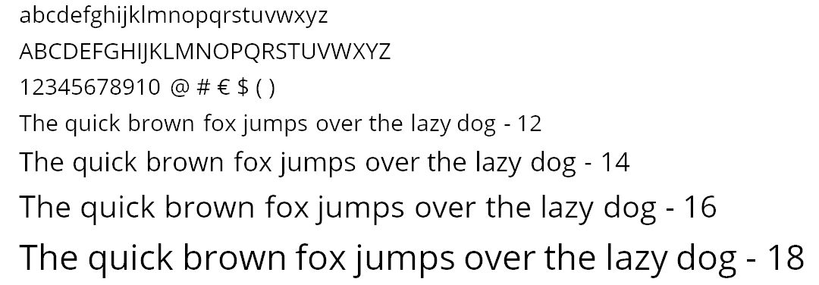
Typography
/ Fonts
Open Sans is the recommended font. Contains all styles: regular, bold and italic.
As an alternative to Open Sans: Vollkorn. Other suggested fonts: in VIM.
Avoid unusual or bizarre fonts, unless the target audience fits with your choice.

Slide 21

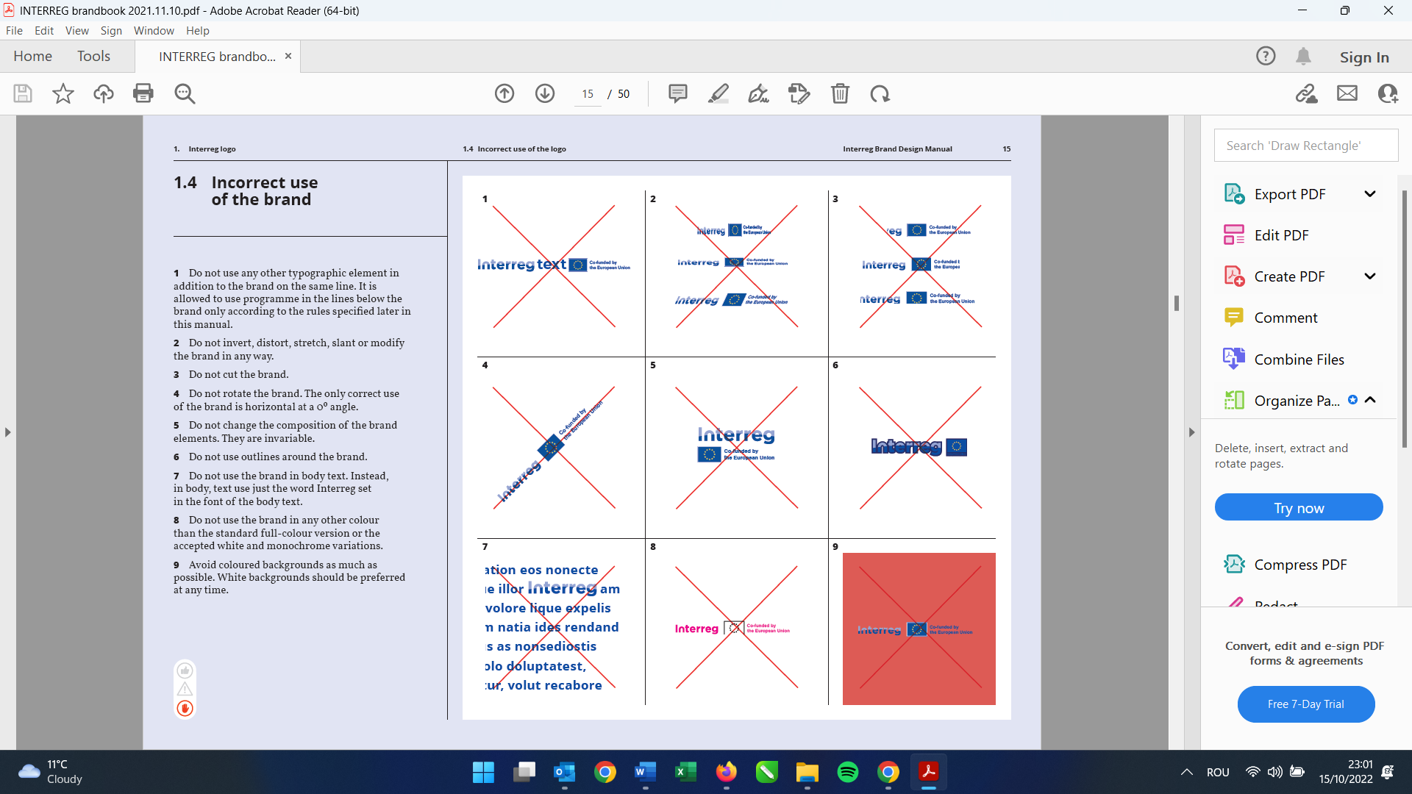
Incorrect use of the Programme logo
Do not use the 2014-2020 Programme logo.
Do not use any other typographic element in addition to the Programme logo.
Do not invert, distort, stretch, slant or modify the logo in any way.
Do not cut the logo.
Do not rotate the logo. The only correct use of the brand is horizontal at a 0º angle.
Do not change the composition of the brand elements. They are invariable.
Do not use outlines around the brand logo.
Do not use the brand in body text.
Do not use the brand in any other colour than the standard full-colour version or the accepted white and monochrome variations.
Avoid coloured backgrounds as much as possible. White backgrounds should be preferred at any time.

Slide 22

Help & Partner Support
To ensure smooth delivery, as a good practice rule, please send your drafts or enquiries at least 10 working days before your publishing or printing deadlines, in case changes are required. In your e-mails, always include your assigned JS project manager as well.
Send your enquires at:
dani.bardos@brct-timisoara.ro
carmen.stojanovic@brct-timisoara.ro
Phone: +40 356.426.360 Fax: +40 356.426.361
Postal address: BRCT Timisoara Str. Proclamatia de la Timisoara nr. 5, 300054, Timisoara, Romania

