Slide 1
INTERREG IPA ROMANIA-SERBIA PROGRAMME
Reporting to Controllers
within the First Level Control Unit
Guidelines to help project partners understand
their responsibilities at control level

Slide 2

Purpose of the
verification
The controllers will verify the compliance with the rules referring to the following issues:
Sound financial management
Double financing
Public procurement
Publicity rules
Compliance with the requirements about equality between men and women and non-discrimination, verification based on comparison of the Partner progress report with the Application Form.
Sustainable development, verification based on comparison of the Partner progress report with the Application Form.
Conflict of interest and any suspicion of fraud.
The eligibility of the reported expenses and whether they are in line with the programme rules.

Slide 3

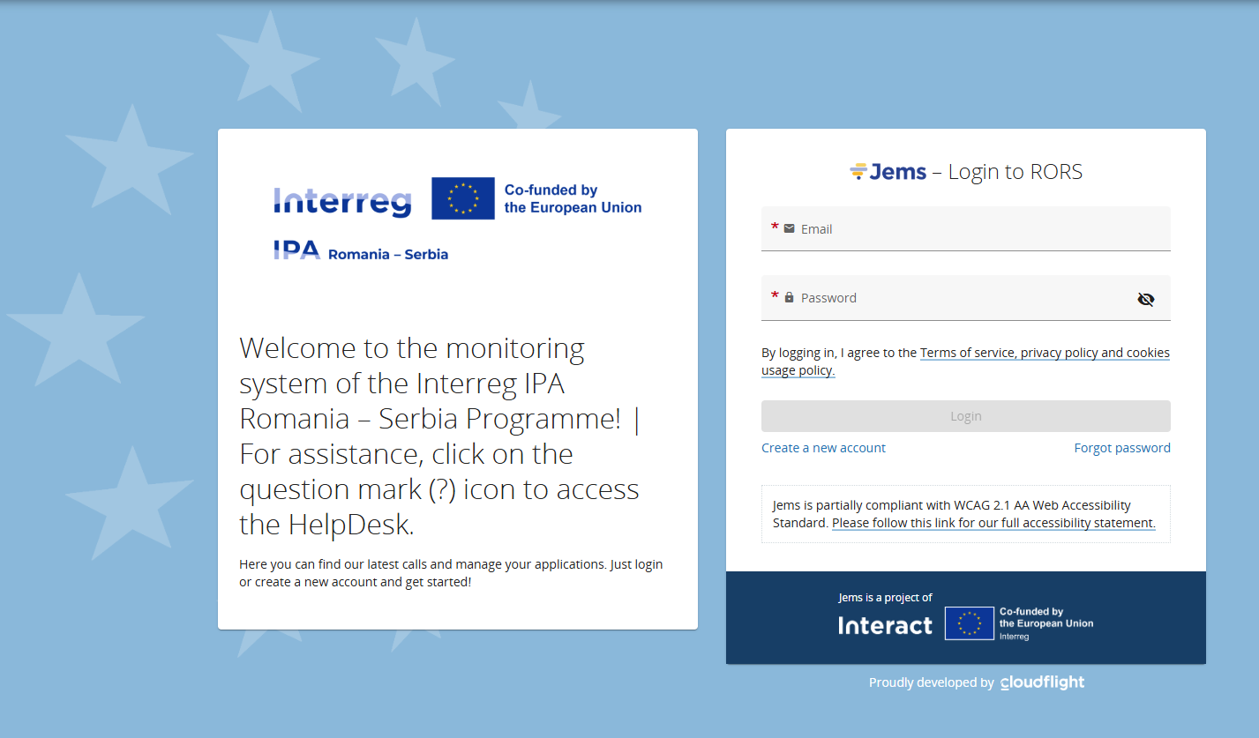
General principles
of reporting
The general reporting process in Jems can be found in following link:
https://jems.interact.eu/manual/

Slide 4
project code (Jems code)
and the name of the Programme:
RORS...
Interreg IPA Romania-Serbia Programme
Preparation of supporting documents for control:
Before uploading the scanned invoices, the originals must be marked with the project code (Jems code) and the name of the Programme.
Submission of project documentation for control:
The PP/LP submits through Jems the electronic version of the Partner Report and the corresponding supporting documents. Partner Report should be submitted to the controller, even if no expenditure was incurred in that respective period. Technical progress should be reported.
Desk-check and on-the-spot check by the controllers:
Controller will check the items of expenditure entered in the accounting system, the supporting documents (such as invoices, delivery notes, goods received records, procurements documents etc.), may ask for additional information;
The Controller may perform the control on-site for the ongoing operations at any time this is found necessary. The On-the-spot visits shall be made whenever in the reporting period works or supplies have been reported but at least once during project’s lifetime.

Slide 5
The controller validates the eligible expenditure in Jems and generates the Control Report, Control Certificate. In addition, the controller completes checklists, on-the spot verifications, procurement checklists as applicable.
Consolidated Progress Report and Reimbursement Claim:
7
Project Partner (PP)
Lead Partner (LP)
3
6
1
2
4
Controllers
Joint Secretariat (JS)
Managing Authority (MA)
5

Slide 6
Write the reports in a way that is understandable also for people outside your specific field of expertise.
Be truthful and honest in the explanations.
Make references to the project activities and deliverables and make sure that your activities are in line with the set objectives.

Slide 7
At least one report is made for each reporting period.
In some cases, the period may be shorter than the full 3 months.
NB: In case a partner created and submitted one or more reports before the end of the reporting period, that partner should create another partner report (reports) covering the remaining part of the reporting period for progress of activities.

Slide 8
AVOID THE EXCEED OF BUDGET – consult the budget before spending and reporting to the national control!
During implementation consult your budget execution.
MA sends it together with the Notification of the authorized eligible expenditure from the previous project report – attached in the Verification Communication Section from the previous Project Report in JEMS.
Notify in due time the JS for issuing an addendum/notification in case you need to revise your budget on a sub-budgetary line with a proper justification.

Slide 9
Report identification,
Work plan progress
List of expenditure
(only for partner reports with expenditure)
Report annexes
Public procurements
Partner and period are determined by the partner report itself (each report refers to just one partner and one period of time).
Trial balances (listed monthly) and the Journal Register.
The complete tender dossier must be uploaded at this section and link it to the corresponding invoice.
each partner report refers to just one partner and one reference period. This section focuses on activities implemented throughout the reporting period. It contains general descriptions of activities, outputs, as well as reporting of progress for purchasing equipment / services / works related to the respective activity.
Bank account statements in EUR and RON, accounts opened specifically for the project. Accounting entries, account statements, as applicable.
Beneficiaries must report expenditure in accordance with the detailed budget.
All information (e.g. Cost category, Investment no. Procurement, Internal reference no. Invoice, Invoice date, Date of payment, Description etc.) must be completed for every item added.

Slide 10
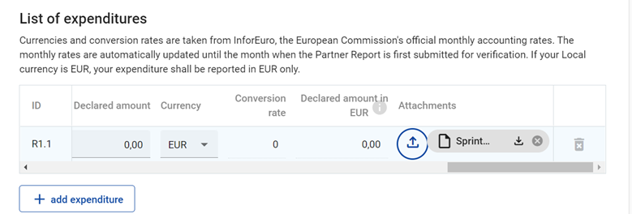

Costs under budget line Staff, Travel & Accommodation and Office and administration will be reimbursed on a flat rate basis, which means that no supporting documents are checked during verification.
For the reported expenditure, the following supporting documents will be attached:
External expertise and services - upload section: invoice, proof of payment (payment order, statement of account) documents related to reception and acceptance;
Equipment expenditure - upload section: invoice and proof of payment (payment order, statement of account) documents related to reception and acceptance;
Infrastructure and works - upload section: invoice and proof of payment (payment order, statement of account), documents related to reception and acceptance;

Slide 11

The entire procurement documentation shall be uploaded in the upload section of each procurement contract (Public procurements):
Procurement files: tender dossier, announcement, bids from tenderers, evaluation process, award documents, all relevant documents related to this procurement …;
NB: Recording all the procurements above 2.500 EUR of the project is compulsory!
In case you don’t upload procurements in this section, you won’t be able to request it for the control verification and your control request (partner report) may be reverted!

Slide 12

The files attached to archives will be named in accordance with the relevant content of documents:
  agenda of the seminar / event / conference held at / on, for example:
  Agenda_Conference_Timisoara_23 June 2026
In case the supporting documents are not properly named and/or uploaded without being linked to the corresponding activities, the controller/MA representative may return the whole report to the partner for revision.

Slide 13
Use of standard documents:
4
Imposed by the Programme;
Imposed by the National legislation;
Basic rules
All payments incurred by the project will be made from the project’s designated accounts.
x
To identify all expenses incurred for the project, a separate accounting record will be kept on distinct/separate analytical accounts.
Termination clause

Slide 14
Thank you for your attention
Contact details
Tel: +40 356.426.360
Fax: +40 356.426.361
Website: www.romania-serbia.net

